Slide 1

Embedded Software Design
Ambuj Varshney
ambujv@nus.edu.sg
Notes:
++ Thank you for inviting me to give this talk
++ In this talk, I will present a pathway that can enable us to make wireless embedded systems ubiquitous. I will describe my previous research efforts that tackle the critical challenges that limit the growth of wireless embedded systems. These are related to the growing energy asymmetry that exists between sensing, computation and communication blocks on these platforms.
++ Finally, I will conclude my talk by covering the research agenda that I would like to work on as a faculty member.

Slide 2
Course Information
Notes:
++ Over the past few years, I have designed several backscatter and beyond backscatter systems that precisely overcome these critical challenges that have limited the widespread deployment of backscatter on IoT devices.
++ The research vision that I have pursued and would like to pursue as a faculty member is to enable a massive deployment of IoT devices by bridging the energy asymmetry between sensing, computation and communication blocks by designing novel platforms and communication mechanisms. I am going to describe some of my research contributions next.

Slide 3
Administrative Stuff
Deadline for project problem, seminar paper selection: 10th March 2024
Equipment for Project: End of recess week (Before 4th March 2024)
List of papers for seminar and student selection
Project can be done in a group of two. We would need statement of work
Term paper, Student Seminar are INDIVIDUAL tasks
Notes:
Backscatter communication actually help us overcome this limitation

Slide 4
Important Deadlines
Event | Date
Lectures | Starting Week 1 (15th January)
Student seminar paper selection | 10th of March 2024
Finalising project statement | 10th of March 2024
Student seminars | Lectures from 18th March
Project presentation | 15th April 2024
Term paper submission | 19th April 2024
Project submission | 19th April 2024

Slide 5
Let us recall what we covered in the last lecture
Notes:
++ Over the past few years, I have designed several backscatter and beyond backscatter systems that precisely overcome these critical challenges that have limited the widespread deployment of backscatter on IoT devices.
++ The research vision that I have pursued and would like to pursue as a faculty member is to enable a massive deployment of IoT devices by bridging the energy asymmetry between sensing, computation and communication blocks by designing novel platforms and communication mechanisms. I am going to describe some of my research contributions next.

Slide 6
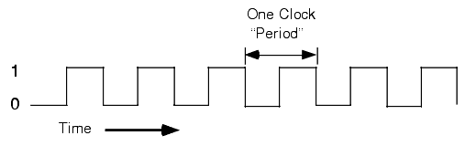
Clocks are heartbeat of the embedded systems
Clock signals are heartbeats of embedded systems. They are digital signals with varied frequency
A clock is required for running any peripheral or core of microcontroller
Exceptions: Low-power input interrupts, Reset signal

Slide 7
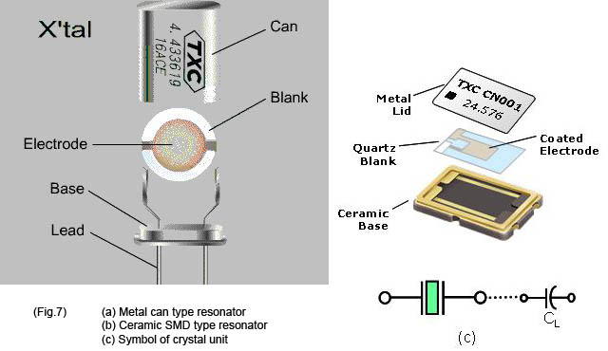
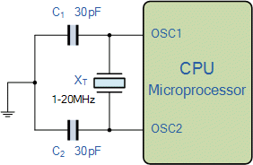
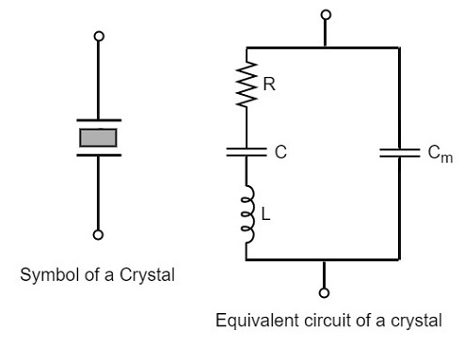
Generating clocks
External crystal oscillator
Creates clock signal
Chunk of quartz
Behaves like RLC circuit but uses less energy
Internal mechanisms
RC oscillator
Creates clock signal
Less accurate and higher energy than crystal
Phase-Locked Loop (PLL)
Multiply input to create new higher frequency clocks

Slide 8
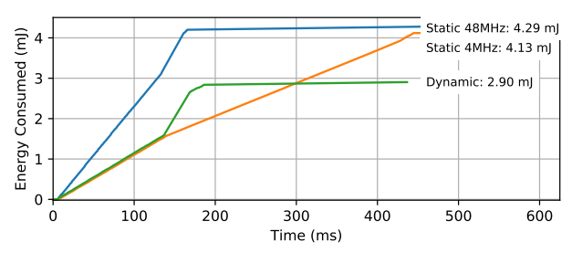
Energy consumption and clock frequency
Fundamental tradeoff between energy consumption and clock frequency
Faster clock gets things done faster but uses more energy
Slower clock uses less energy but gets things done slower
Which to use depends on the situation
Example of clock selection for a mixed load (part IO, part CPU)
Energy consumed becomes a horizontal line when the task is completed
Chiang et al. “Power Clocks: Dynamic Multi-Clock Management for Embedded Systems” EWSN 2021

Slide 9
Controlling clock frequency and power consumption
Microcontrollers provide extremely fine-grained control over clocks
Manually enable/disable clocks as needed
nRF52 instead gives almost no control but is easier to use
One 64-MHz clock for processor
Multiple peripheral clocks, but (most) peripherals are hardwired to one
16 MHz for almost all peripherals (PDM and I2S are 32 MHz)
Low-frequency 32 kHz clock for low-power peripherals
Automatically enables/disables clocks

Slide 10
Timer peripherals
Common need for embedded systems: sense of time
Start this behavior after a certain amount of time
Stop this behavior after a certain amount of time
Measure how much time passed between two events
Timer peripherals
Input is one of the system clocks
Counts up a register at each clock tick
Compare to saved value and trigger interrupt on match

Slide 11
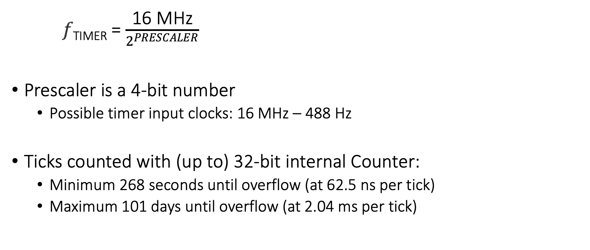
Input and Prescaler
𝑓_{TIMER} = $\frac{\text{16 }\text{MHz}}{2^{PRESCALER}}$
Prescaler is a 4-bit number
Possible timer input clocks: 16 MHz – 488 Hz
Ticks counted with (up to) 32-bit internal Counter:
Minimum 268 seconds until overflow (at 62.5 ns per tick)
Maximum 101 days until overflow (at 2.04 ms per tick)

Slide 12
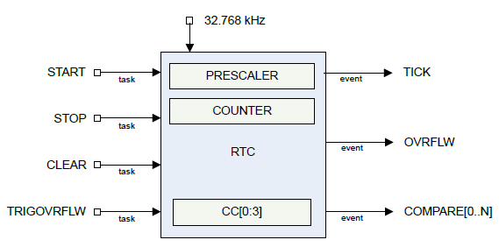
Real-time Counter
Low-power (32 kHz) version of Timer
Only a 24-bit internal Counter

Slide 13
Differences between Real-Time Counter and Timer
Runs off of LFCLK instead of HFCLK
With smaller prescaler value (4096 vs 32768)
24-bit counter vs 32-bit counter for Timer
Can read the Counter value directly
No need for Capture task
Otherwise extremely similar. Just a low-power version of Timer

Slide 14
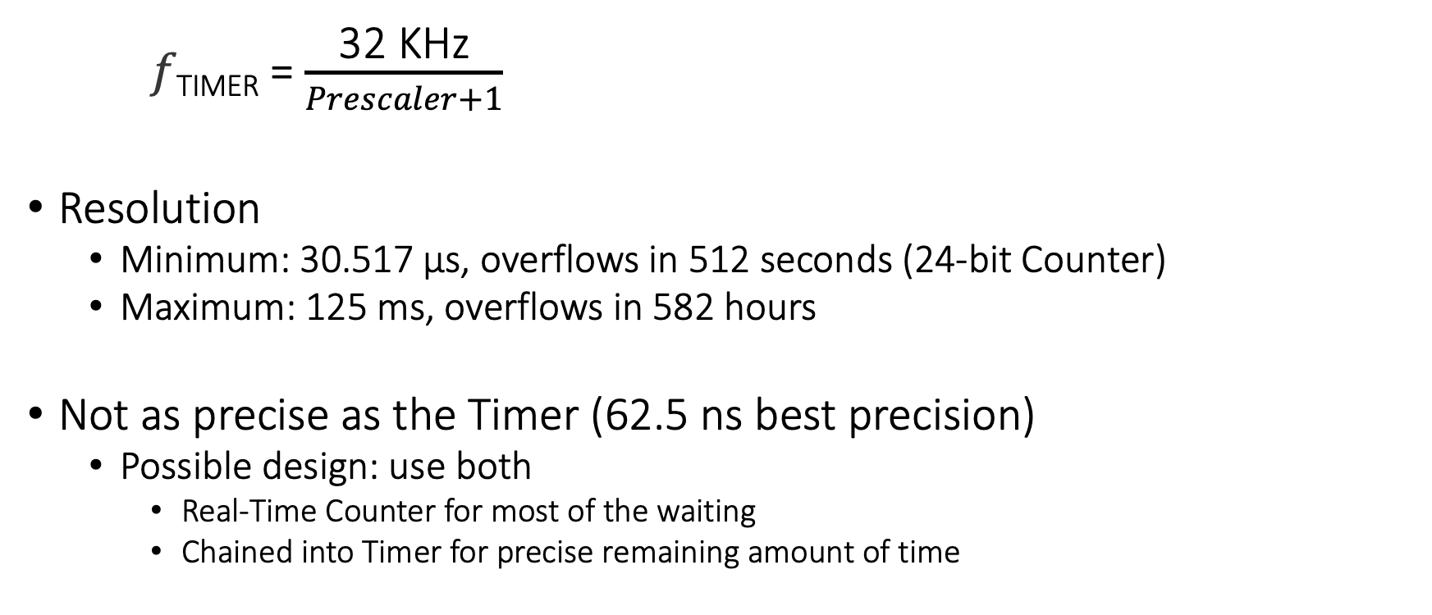
Time resolution for Real-Time Counter
𝑓_{TIMER} = $\frac{\text{32} \text{K}\text{Hz}}{Prescaler+1}$
Resolution
Minimum: 30.517 μs, overflows in 512 seconds (24-bit Counter)
Maximum: 125 ms, overflows in 582 hours
Not as precise as the Timer (62.5 ns best precision)
Possible design: use both
Real-Time Counter for most of the waiting
Chained into Timer for precise remaining amount of time

Slide 15
Terms/Units (Quick Revision)
Voltage: Volts (V): the SI unit of electromotive force
Current: Ampere or “amp” (A) is the SI unit of electric current
Power (W): volts (V) x amps (A)
Energy (Joule): Power x Time.
Example:
A device running at 1V draws 1A.
The power consumption is therefore 1W
Energy consumed in 1s is 1J

Slide 16
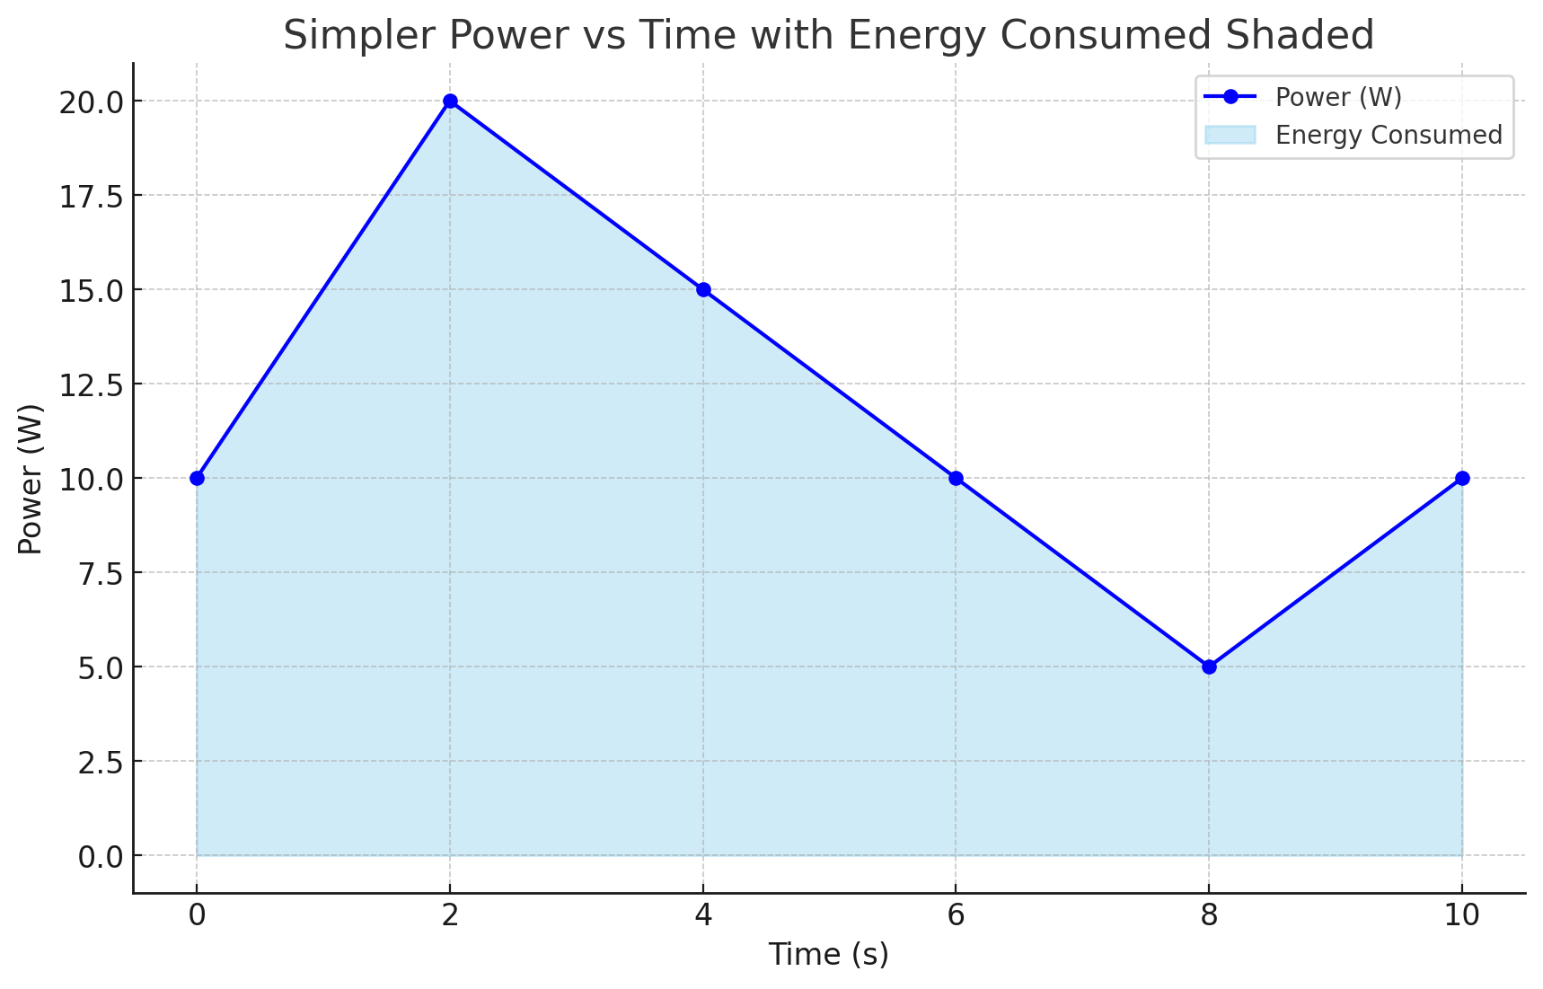
Relationship between power, energy and time

Slide 17
How do you measure the capacity of a battery?
The watt-hour (symbolized Wh) is a unit of energy equivalent to one watt (1 W) of power that is expended for one hour (1 h) of time.
Macbook Pro 16 Inch: 99.6 Watt-hour
iPad pro 12.9 Inch: 40.88 Watt-hour
An ampere-hour or amp-hour (Ah) is a unit of electric charge equal to the charge transferred by a steady current of 1A flowing for one hour:
AA Energizer Alkaline: 2500 mAh (1.5V), 3.75Wh

Slide 18
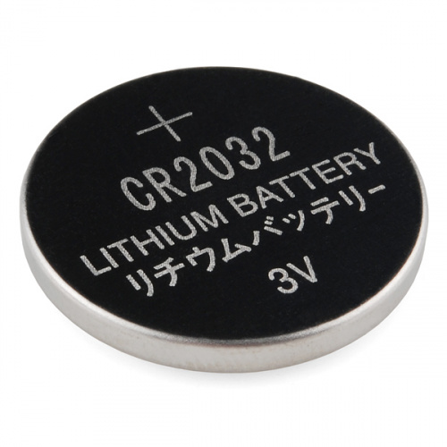
What is the capacity of the battery?
How do we calculate the lifetime of the battery in IoT devices?
We express battery capacity commonly in milliampere-hour (mAH)
Coin cell (CR2032): 240 mAh, Flexible battery (Molex): 10 mAh
How long would battery last under different device load:
Current drawn | Lifetime
240 mA | 1 h
120 mA | 2 h
1 mA | 240 h
Coin cell battery
CR 2032 (240 mAh)

Slide 19
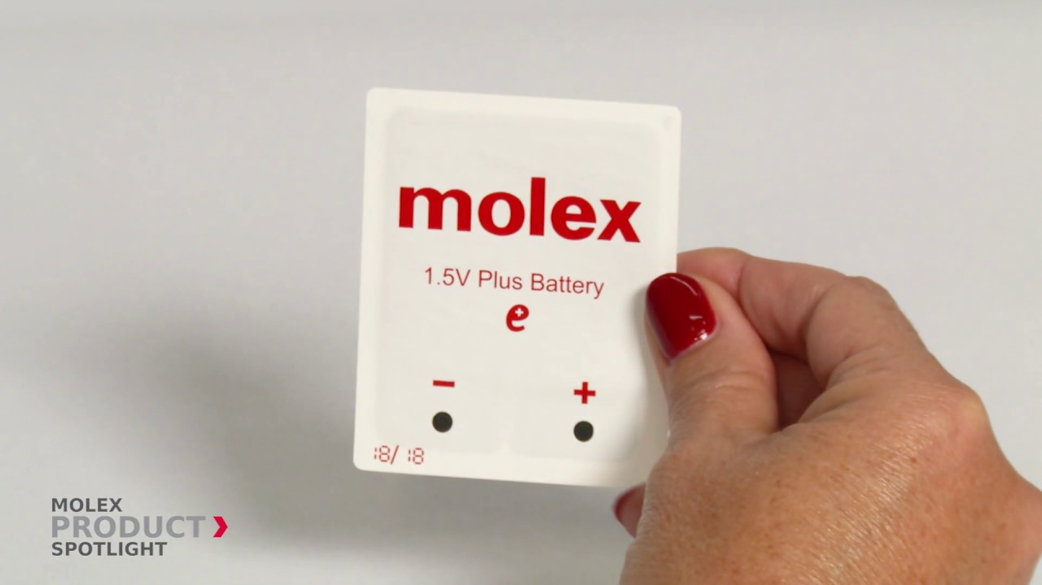
Expected lifespan of a battery in an IoT devices?
Coin cell (CR2032): 240 mAh, Flexible battery (Molex): 10 mAh
What is the battery life under different device loads:
Coin cell battery
CR 2032 (240 mAh)
Flexible Battery
(10 mAh)
Component | Current draw | Flexible Battery | Coin cell
Microcontroller | 200 uA | 50 h | 1200 h
Accelerometer | 10 uA | 1000 h | 24000
WiFi Radio | 15 mA | 45 mins | 16 h
Bluetooth radio | 1 mA | 10 h | 240 h

Slide 20
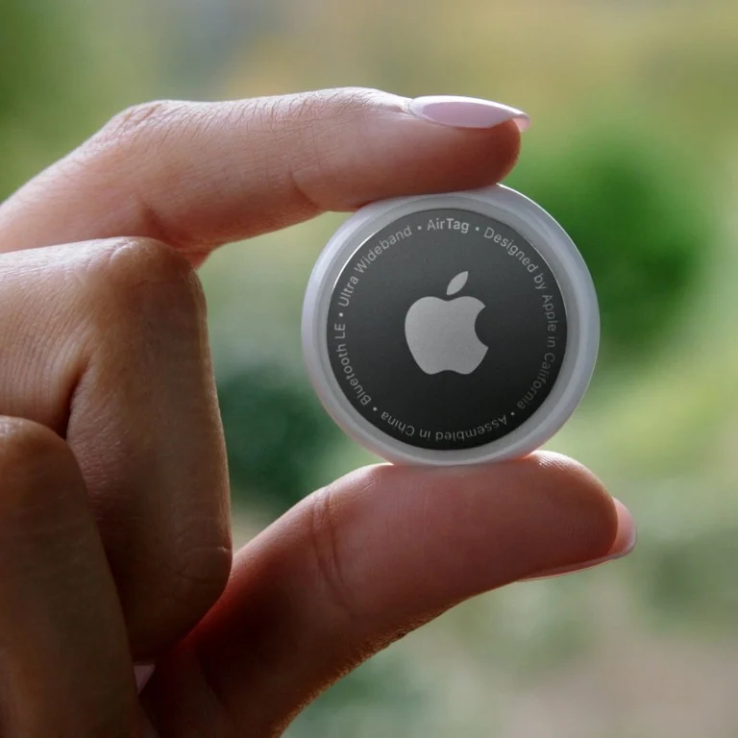
Battery Capacity: Apple AirTag

Slide 21
Battery Capacity: Apple AirTag
Coin Cell: 240 mAH

Slide 22
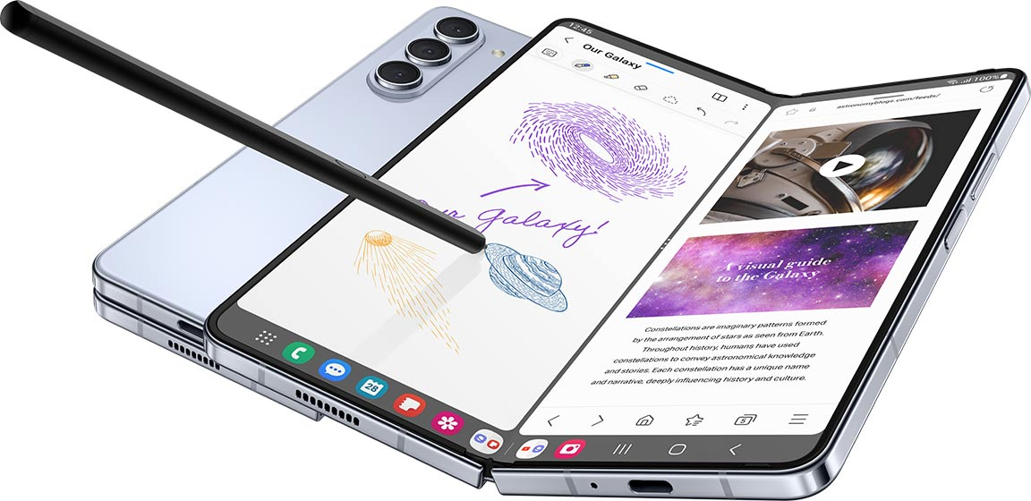
Battery Capacity: Smartphone

Slide 23
Battery Capacity: Smartphone
Lithium Ion: 3400 - 6000 mAH

Slide 24
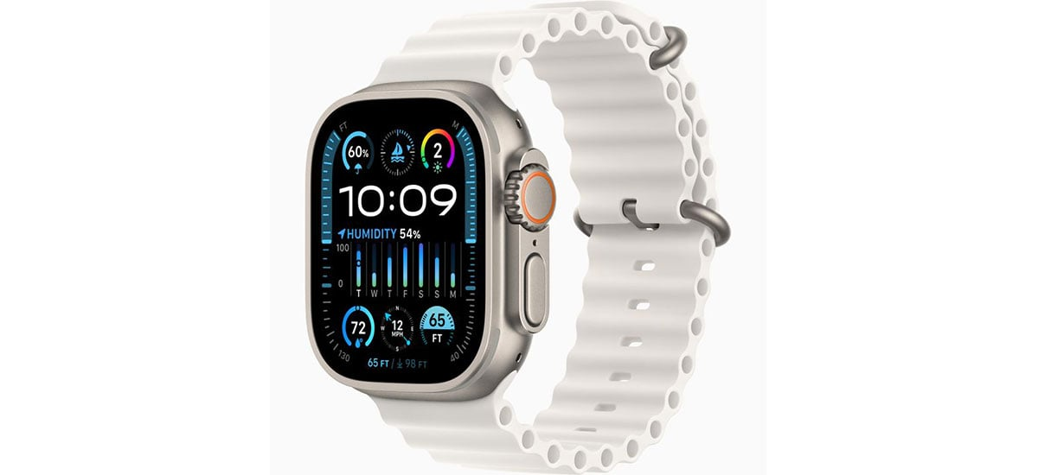
Battery Capacity: Smartwatch

Slide 25
Battery Capacity: Smartwatch
Smart watch: 400-600 mAH

Slide 26
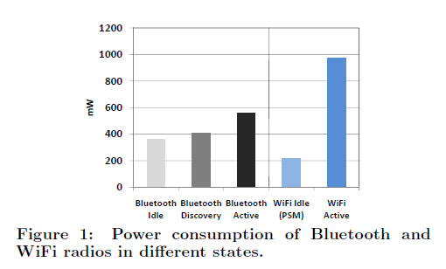
Different transmission states for wireless networking
Devices rarely transmit continuously.
Having different power states allow power consumption to be reduced

Slide 27
Spikes in the power consumption of smartphones are due to wireless networking events
WiFi state transition for beacon communication is (relatively) fast
However, state transition for data communication is (still) slow due to driver/software overhead

Slide 28
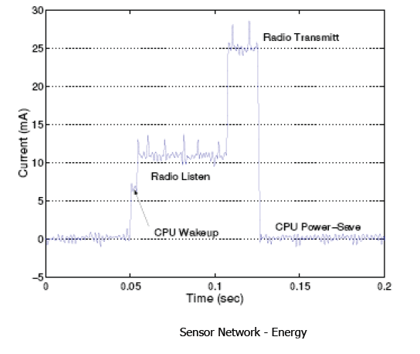
Current consumption for a wireless embedded device for various states of the radio transceiver

Slide 29
Energy Characteristics of LCD Display
Most of the power in an LCD display is consumed by the backlight, the light filter requires comparatively less power.
B Anand, K Thirugnanam, J Sebastian, PG Kannan, AL Ananda, MC Chan, RK Balan, “Adaptive display power management for mobile games,” ACM International Conference on Mobile Systems, Applications, and Services (Mobisys) 2011.

Slide 30
Energy Characteristics of OLED Display [4]
OLED display functions without a backlight
OLED displays consume less power than a LCD display when the image is dark, but more when the image is bright
Displaying different color consumed different amount of energy

Slide 31
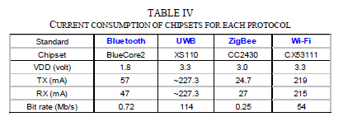
Lifespan estimation for wireless networking
A mobile device with a capacity 9.62Wh transmits continuously on:
WiFi:
Considering only network energy consumption
Power consumption: 3.3V*219mA = 722.7 mW
Duration = 9.62/0.7227 = 13.3hrs
In practice, the duration is much shorter due to other components
Bluetooth: (1.8V * 57mA = 102.6mW)
Duration = 9.62/(1.8*0.057) = 93.76hrs

Slide 32
Different transmission states for wireless networking
Devices rarely transmit continuously.
Having different power states allow power consumption to be reduced
Ashish Sharma, Vishnu Navda, Ramachandran Ramjee, Venkat Padmanabhan, and Elizabeth Belding, Cool-Tether: Energy Efficient On-the-fly WiFi Hot-spots using Mobile Phones, in CoNEXT 2009.

Slide 33
Wi-Fi power consumption on a Samsung Galaxy S4
WiFi state transition for beacon communication is (relatively) fast
However, state transition for data communication is (still) slow due to driver/software overhead

Slide 34
Classical embedded sensor platform: Current Consumption (MICA2 Sensor node)
What are the desirable properties for radio to operate in low power?

Slide 35
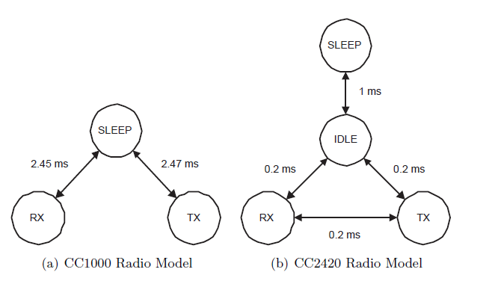
Example of Different Radio States
Energy conserved by placing the radio transceivers into low power states when they are not active

Slide 36
Different radio states of CC2650 (sensor tag)
ARM Cortex-M3: operating frequency up to 48MHz, current in ACTIVE state varies from 1.45mA to 3mA
For comparison,
RaspberryPi 3 (ARM Cortex-A53): 1W - 2W
I7-7600U@2.8GHz (laptop): 7.5W (down), 15W (typical), 25W (up)
I7-7700@3.6GHz (desktop): 65W (typical)

Slide 37
History of Wireless Communication
Notes:
++ Over the past few years, I have designed several backscatter and beyond backscatter systems that precisely overcome these critical challenges that have limited the widespread deployment of backscatter on IoT devices.
++ The research vision that I have pursued and would like to pursue as a faculty member is to enable a massive deployment of IoT devices by bridging the energy asymmetry between sensing, computation and communication blocks by designing novel platforms and communication mechanisms. I am going to describe some of my research contributions next.

Slide 38

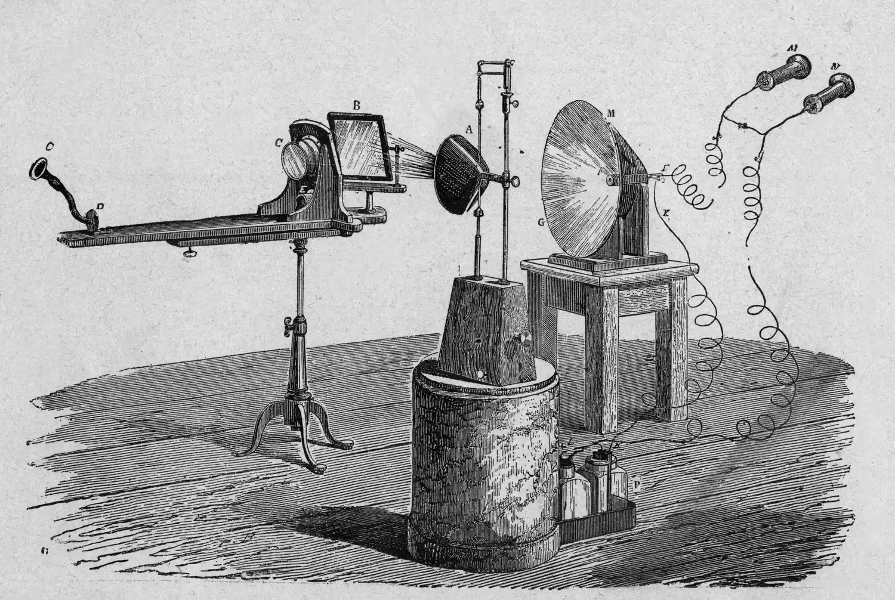
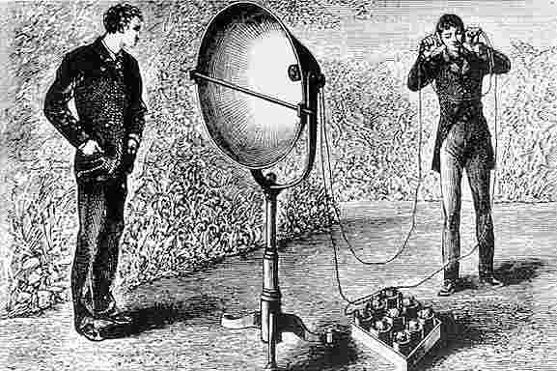
History of Wireless Transmissions
First to demonstrate wireless communication ?
1880: Alexander Graham Bell and his assistant Charles Sumner Tainter at the Bell Labs invented the photophone
Photophone: a device that transmitted sound on a beam of light
Notes:
First, we look at the computational elements, and these consist of a microcontroller or an FPGA. Today, we find that these computational elements consume at least one order of magnitude higher power consumption when compared to the commonly used sensors.
However, we also find that microcontrollers are increasingly becoming energy efficient. We investigate a typical microcontroller that has been used in sensor platforms over the past two decades. We find that energy efficiency has improved by almost two orders of magnitude. Some of the present-generation microcontrollers, such as Ambiq Apollo4 consume just 3 uA/MHz than 330 uA for MSP430 used on platforms such as TelOS B.
If the trend continues, we can expect the microcontrollers to catch up with the sensors and become energy-efficient. This significant improvement is that the digital components are increasing becoming efficient as they follow moore’s law.

Slide 39

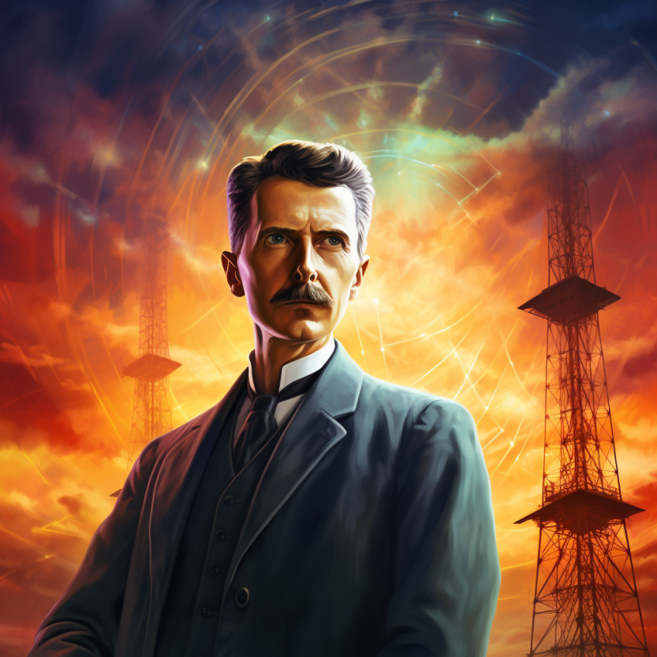
History of Wireless Transmissions
First to demonstrate wireless communication ?
1893: Nikola Tesla gave a public demonstration of "wireless" radio communication at St. Louis, Missouri, USA
Notes:
First, we look at the computational elements, and these consist of a microcontroller or an FPGA. Today, we find that these computational elements consume at least one order of magnitude higher power consumption when compared to the commonly used sensors.
However, we also find that microcontrollers are increasingly becoming energy efficient. We investigate a typical microcontroller that has been used in sensor platforms over the past two decades. We find that energy efficiency has improved by almost two orders of magnitude. Some of the present-generation microcontrollers, such as Ambiq Apollo4 consume just 3 uA/MHz than 330 uA for MSP430 used on platforms such as TelOS B.
If the trend continues, we can expect the microcontrollers to catch up with the sensors and become energy-efficient. This significant improvement is that the digital components are increasing becoming efficient as they follow moore’s law.

Slide 40
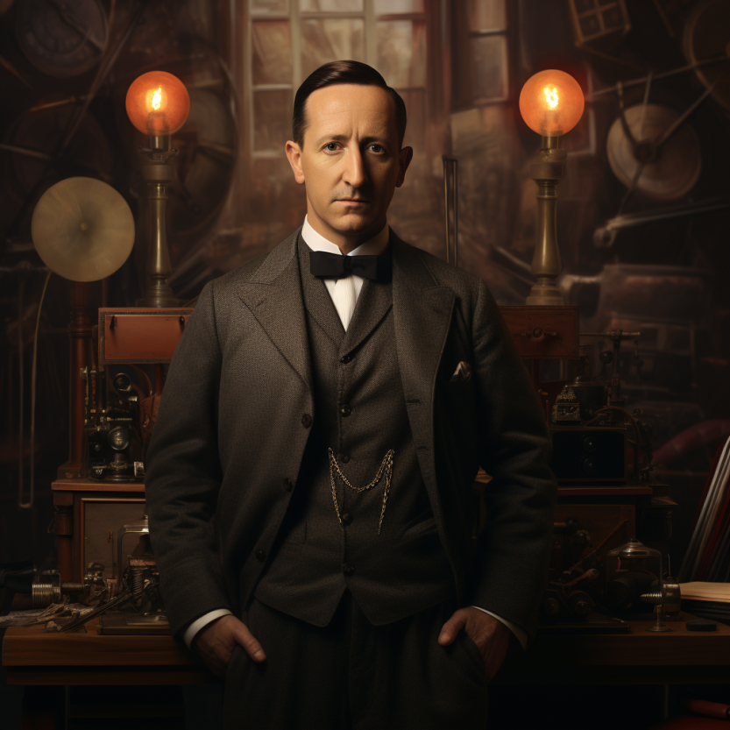
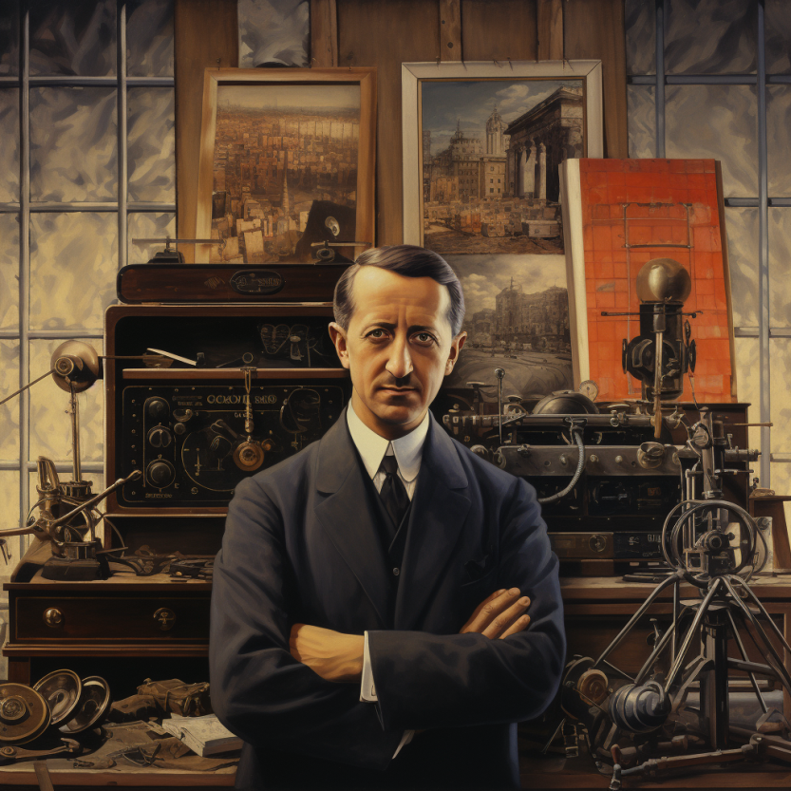
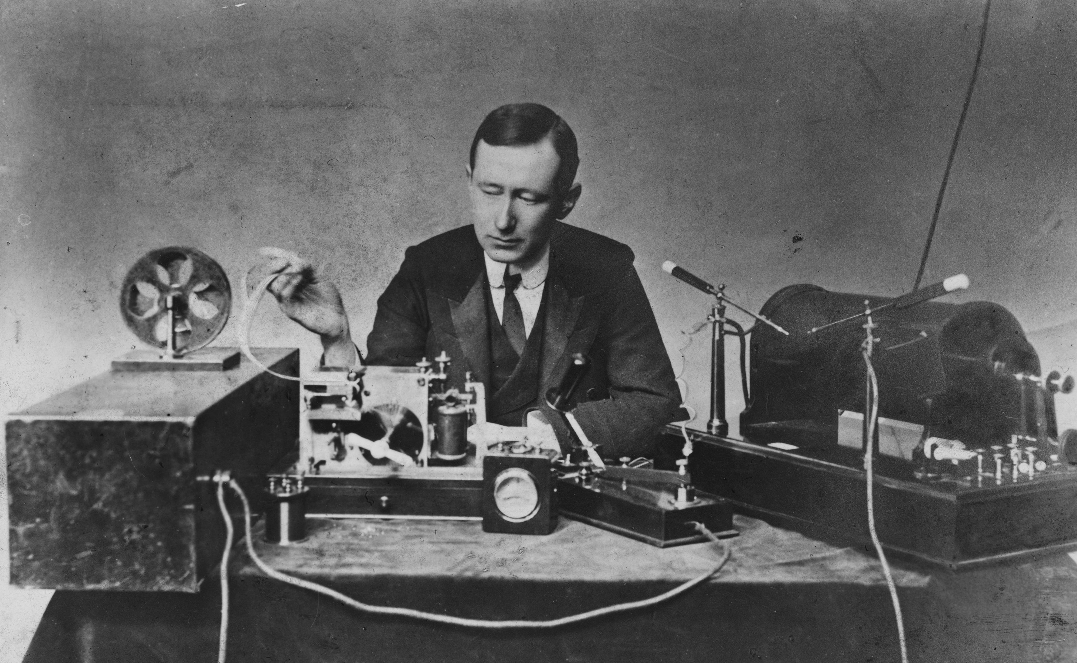
History of Wireless Transmissions
First to demonstrate wireless communication ?
1896: Guglielmo Marconi's first radio transmissions, coded signals that were transmitted only about 1.6 km (a mile)
1899: Marconi sends a signal over the English Channel ~50km
Notes:
First, we look at the computational elements, and these consist of a microcontroller or an FPGA. Today, we find that these computational elements consume at least one order of magnitude higher power consumption when compared to the commonly used sensors.
However, we also find that microcontrollers are increasingly becoming energy efficient. We investigate a typical microcontroller that has been used in sensor platforms over the past two decades. We find that energy efficiency has improved by almost two orders of magnitude. Some of the present-generation microcontrollers, such as Ambiq Apollo4 consume just 3 uA/MHz than 330 uA for MSP430 used on platforms such as TelOS B.
If the trend continues, we can expect the microcontrollers to catch up with the sensors and become energy-efficient. This significant improvement is that the digital components are increasing becoming efficient as they follow moore’s law.

Slide 41
Terminology used in Wireless Networking
Notes:
++ Over the past few years, I have designed several backscatter and beyond backscatter systems that precisely overcome these critical challenges that have limited the widespread deployment of backscatter on IoT devices.
++ The research vision that I have pursued and would like to pursue as a faculty member is to enable a massive deployment of IoT devices by bridging the energy asymmetry between sensing, computation and communication blocks by designing novel platforms and communication mechanisms. I am going to describe some of my research contributions next.

Slide 42

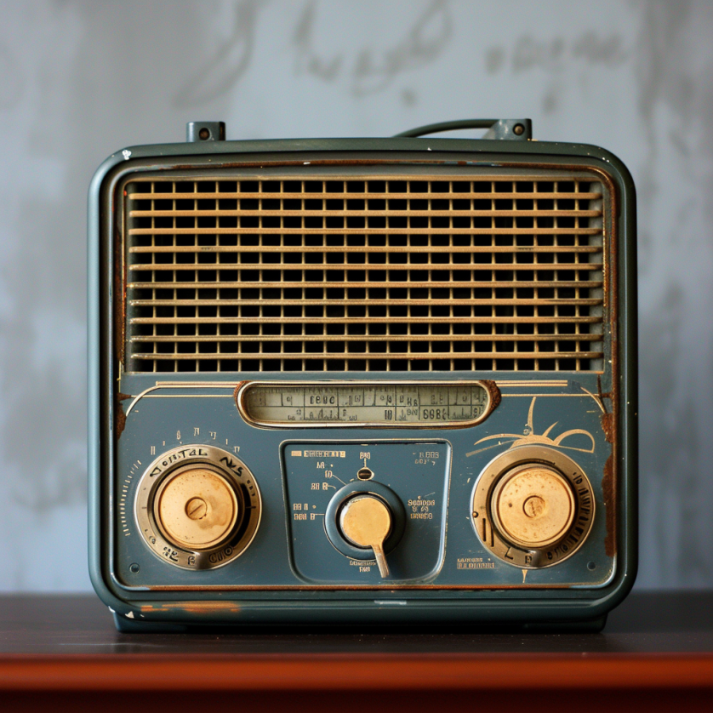
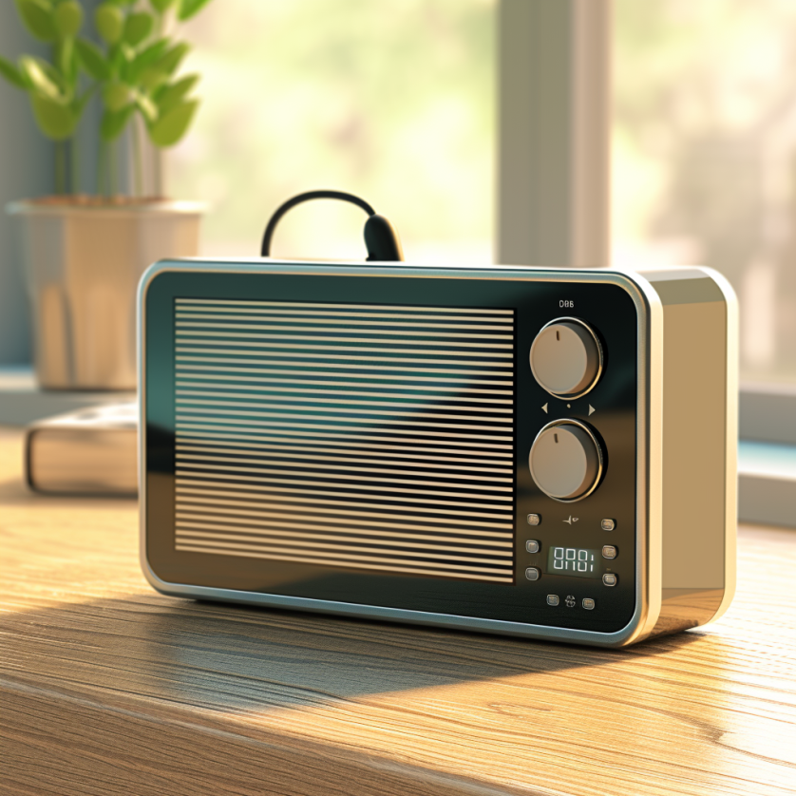
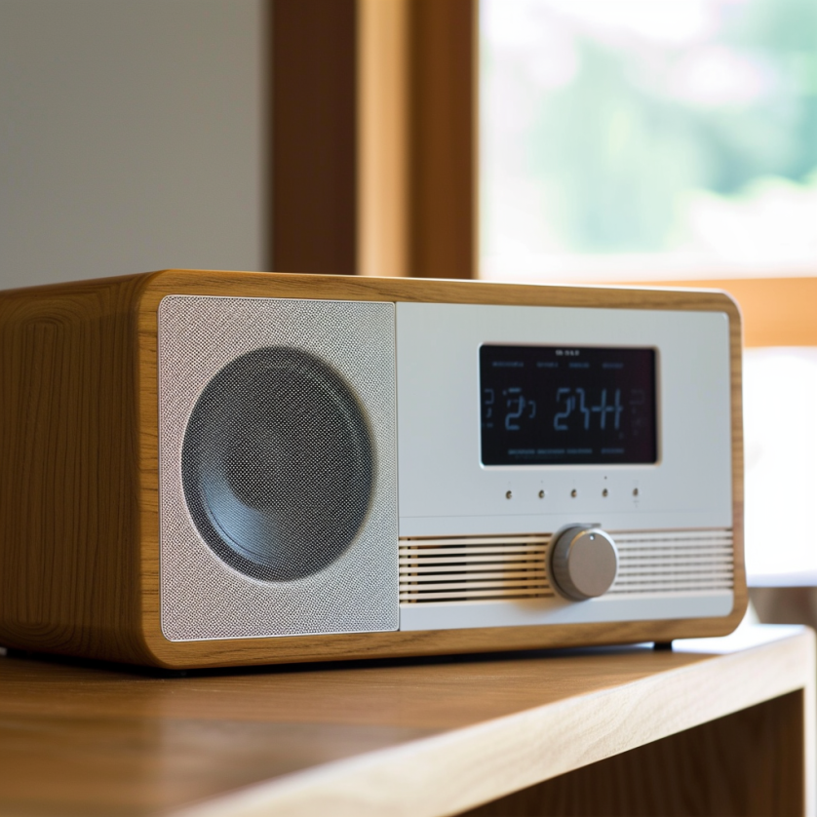
What does the term radio means?
Notes:
First, we look at the computational elements, and these consist of a microcontroller or an FPGA. Today, we find that these computational elements consume at least one order of magnitude higher power consumption when compared to the commonly used sensors.
However, we also find that microcontrollers are increasingly becoming energy efficient. We investigate a typical microcontroller that has been used in sensor platforms over the past two decades. We find that energy efficiency has improved by almost two orders of magnitude. Some of the present-generation microcontrollers, such as Ambiq Apollo4 consume just 3 uA/MHz than 330 uA for MSP430 used on platforms such as TelOS B.
If the trend continues, we can expect the microcontrollers to catch up with the sensors and become energy-efficient. This significant improvement is that the digital components are increasing becoming efficient as they follow moore’s law.

Slide 43
What does the term radio means?
The term radio originates from the Latin "radius," signifying "spoke of a wheel" or "ray of light." It was first used in communication context in 1881. French scientist Ernest Mercadier suggested the term, leading Alexander Graham Bell to name his photophone system "radiophone," which translates to "radiated sound."
Notes:
First, we look at the computational elements, and these consist of a microcontroller or an FPGA. Today, we find that these computational elements consume at least one order of magnitude higher power consumption when compared to the commonly used sensors.
However, we also find that microcontrollers are increasingly becoming energy efficient. We investigate a typical microcontroller that has been used in sensor platforms over the past two decades. We find that energy efficiency has improved by almost two orders of magnitude. Some of the present-generation microcontrollers, such as Ambiq Apollo4 consume just 3 uA/MHz than 330 uA for MSP430 used on platforms such as TelOS B.
If the trend continues, we can expect the microcontrollers to catch up with the sensors and become energy-efficient. This significant improvement is that the digital components are increasing becoming efficient as they follow moore’s law.

Slide 44
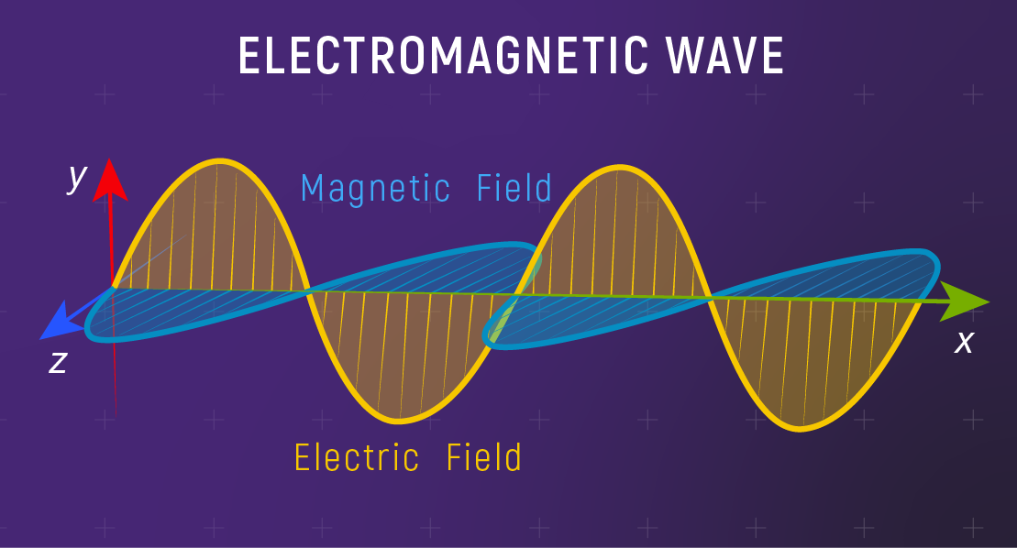
Fundamentals of electromagnetic waves
Electromagnetic (EM) waves are synchronized oscillations of electric and magnetic field. There is a periodic change of electric and magnetic field
How often this periodic change occurs dictates the property of EM waves
Notes:
First, we look at the computational elements, and these consist of a microcontroller or an FPGA. Today, we find that these computational elements consume at least one order of magnitude higher power consumption when compared to the commonly used sensors.
However, we also find that microcontrollers are increasingly becoming energy efficient. We investigate a typical microcontroller that has been used in sensor platforms over the past two decades. We find that energy efficiency has improved by almost two orders of magnitude. Some of the present-generation microcontrollers, such as Ambiq Apollo4 consume just 3 uA/MHz than 330 uA for MSP430 used on platforms such as TelOS B.
If the trend continues, we can expect the microcontrollers to catch up with the sensors and become energy-efficient. This significant improvement is that the digital components are increasing becoming efficient as they follow moore’s law.

Slide 45
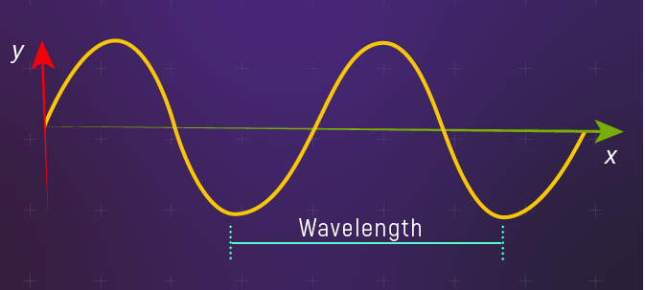
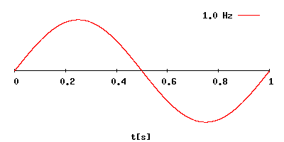
Fundamentals of electromagnetic waves
Electromagnetic (EM) waves are synchronized oscillations of electric and magnetic field. There is a periodic change of electric and magnetic field
How often this periodic change occurs dictates the property of EM waves
Changer period is termed as the frequency. The SI unit for frequency is Hertz (Hz)
1 Hz: one cycle of an electromagnetic wave in a second
Notes:
First, we look at the computational elements, and these consist of a microcontroller or an FPGA. Today, we find that these computational elements consume at least one order of magnitude higher power consumption when compared to the commonly used sensors.
However, we also find that microcontrollers are increasingly becoming energy efficient. We investigate a typical microcontroller that has been used in sensor platforms over the past two decades. We find that energy efficiency has improved by almost two orders of magnitude. Some of the present-generation microcontrollers, such as Ambiq Apollo4 consume just 3 uA/MHz than 330 uA for MSP430 used on platforms such as TelOS B.
If the trend continues, we can expect the microcontrollers to catch up with the sensors and become energy-efficient. This significant improvement is that the digital components are increasing becoming efficient as they follow moore’s law.

Slide 46
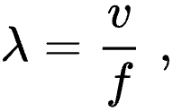
Wavelength of an electromagnetic wave
Wavelength of a sinusoidal waveform travelling at speed (v), frequency (f)
Electromagnetic waves that are travelling in free space, the speed is c or the speed of light. What is speed of light?
Notes:
First, we look at the computational elements, and these consist of a microcontroller or an FPGA. Today, we find that these computational elements consume at least one order of magnitude higher power consumption when compared to the commonly used sensors.
However, we also find that microcontrollers are increasingly becoming energy efficient. We investigate a typical microcontroller that has been used in sensor platforms over the past two decades. We find that energy efficiency has improved by almost two orders of magnitude. Some of the present-generation microcontrollers, such as Ambiq Apollo4 consume just 3 uA/MHz than 330 uA for MSP430 used on platforms such as TelOS B.
If the trend continues, we can expect the microcontrollers to catch up with the sensors and become energy-efficient. This significant improvement is that the digital components are increasing becoming efficient as they follow moore’s law.

Slide 47
Wavelength of an electromagnetic wave
Wavelength of a sinusoidal waveform travelling at speed (v), frequency (f)
Electromagnetic waves that are travelling in free space, the speed is c or the speed of light. What is speed of light? 3×10⁸ m/s
Different color of light, different wavelength!
Notes:
First, we look at the computational elements, and these consist of a microcontroller or an FPGA. Today, we find that these computational elements consume at least one order of magnitude higher power consumption when compared to the commonly used sensors.
However, we also find that microcontrollers are increasingly becoming energy efficient. We investigate a typical microcontroller that has been used in sensor platforms over the past two decades. We find that energy efficiency has improved by almost two orders of magnitude. Some of the present-generation microcontrollers, such as Ambiq Apollo4 consume just 3 uA/MHz than 330 uA for MSP430 used on platforms such as TelOS B.
If the trend continues, we can expect the microcontrollers to catch up with the sensors and become energy-efficient. This significant improvement is that the digital components are increasing becoming efficient as they follow moore’s law.

Slide 48
What does the term radio mean?
Radio technology implies the task of transmission and reception of information using electromagnetic waves of frequency 3 Hz to 300 GHz. Electromagnetic waves at these frequencies are also called radio waves, and the frequency bands are called radio spectrum.
Notes:
First, we look at the computational elements, and these consist of a microcontroller or an FPGA. Today, we find that these computational elements consume at least one order of magnitude higher power consumption when compared to the commonly used sensors.
However, we also find that microcontrollers are increasingly becoming energy efficient. We investigate a typical microcontroller that has been used in sensor platforms over the past two decades. We find that energy efficiency has improved by almost two orders of magnitude. Some of the present-generation microcontrollers, such as Ambiq Apollo4 consume just 3 uA/MHz than 330 uA for MSP430 used on platforms such as TelOS B.
If the trend continues, we can expect the microcontrollers to catch up with the sensors and become energy-efficient. This significant improvement is that the digital components are increasing becoming efficient as they follow moore’s law.

Slide 49
What does the term radio mean?
Radio technology implies the task of transmission and reception of information using electromagnetic waves of frequency 3 Hz to 300 GHz. Electromagnetic waves at these frequencies are also called radio waves, and the frequency bands are called radio spectrum.
What is wavelength for frequency of 3Hz?
Notes:
First, we look at the computational elements, and these consist of a microcontroller or an FPGA. Today, we find that these computational elements consume at least one order of magnitude higher power consumption when compared to the commonly used sensors.
However, we also find that microcontrollers are increasingly becoming energy efficient. We investigate a typical microcontroller that has been used in sensor platforms over the past two decades. We find that energy efficiency has improved by almost two orders of magnitude. Some of the present-generation microcontrollers, such as Ambiq Apollo4 consume just 3 uA/MHz than 330 uA for MSP430 used on platforms such as TelOS B.
If the trend continues, we can expect the microcontrollers to catch up with the sensors and become energy-efficient. This significant improvement is that the digital components are increasing becoming efficient as they follow moore’s law.

Slide 50


What does the term radio mean?
Radio technology implies the task of transmission and reception of information using electromagnetic waves of frequency 3 Hz to 300 GHz. Electromagnetic waves at these frequencies are also called radio waves, and the frequency bands are called radio spectrum.
What is wavelength for frequency of 3Hz? (approx.) 100 Kilometer!
Distance between London and Oxford
Notes:
First, we look at the computational elements, and these consist of a microcontroller or an FPGA. Today, we find that these computational elements consume at least one order of magnitude higher power consumption when compared to the commonly used sensors.
However, we also find that microcontrollers are increasingly becoming energy efficient. We investigate a typical microcontroller that has been used in sensor platforms over the past two decades. We find that energy efficiency has improved by almost two orders of magnitude. Some of the present-generation microcontrollers, such as Ambiq Apollo4 consume just 3 uA/MHz than 330 uA for MSP430 used on platforms such as TelOS B.
If the trend continues, we can expect the microcontrollers to catch up with the sensors and become energy-efficient. This significant improvement is that the digital components are increasing becoming efficient as they follow moore’s law.

Slide 51
What does the term radio mean?
Radio technology implies the task of transmission and reception of information using electromagnetic waves of frequency 3 Hz to 300 GHz. Electromagnetic waves at these frequencies are also called radio waves, and the frequency bands are called radio spectrum.
What is wavelength of 100 MHz (FM Band) ?
Notes:
First, we look at the computational elements, and these consist of a microcontroller or an FPGA. Today, we find that these computational elements consume at least one order of magnitude higher power consumption when compared to the commonly used sensors.
However, we also find that microcontrollers are increasingly becoming energy efficient. We investigate a typical microcontroller that has been used in sensor platforms over the past two decades. We find that energy efficiency has improved by almost two orders of magnitude. Some of the present-generation microcontrollers, such as Ambiq Apollo4 consume just 3 uA/MHz than 330 uA for MSP430 used on platforms such as TelOS B.
If the trend continues, we can expect the microcontrollers to catch up with the sensors and become energy-efficient. This significant improvement is that the digital components are increasing becoming efficient as they follow moore’s law.

Slide 52


What does the term radio mean?
Radio technology implies the task of transmission and reception of information using electromagnetic waves of frequency 3 Hz to 300 GHz. Electromagnetic waves at these frequencies are also called radio waves, and the frequency bands are called radio spectrum.
What is wavelength of 100 MHz (FM Band) ? 3 Meters
Notes:
First, we look at the computational elements, and these consist of a microcontroller or an FPGA. Today, we find that these computational elements consume at least one order of magnitude higher power consumption when compared to the commonly used sensors.
However, we also find that microcontrollers are increasingly becoming energy efficient. We investigate a typical microcontroller that has been used in sensor platforms over the past two decades. We find that energy efficiency has improved by almost two orders of magnitude. Some of the present-generation microcontrollers, such as Ambiq Apollo4 consume just 3 uA/MHz than 330 uA for MSP430 used on platforms such as TelOS B.
If the trend continues, we can expect the microcontrollers to catch up with the sensors and become energy-efficient. This significant improvement is that the digital components are increasing becoming efficient as they follow moore’s law.

Slide 53
What does the term radio mean?
Radio technology implies the task of transmission and reception of information using electromagnetic waves of frequency 3 Hz to 300 GHz. Electromagnetic waves at these frequencies are also called radio waves, and the frequency bands are called radio spectrum.
What is wavelength of 100 GHz?
Notes:
First, we look at the computational elements, and these consist of a microcontroller or an FPGA. Today, we find that these computational elements consume at least one order of magnitude higher power consumption when compared to the commonly used sensors.
However, we also find that microcontrollers are increasingly becoming energy efficient. We investigate a typical microcontroller that has been used in sensor platforms over the past two decades. We find that energy efficiency has improved by almost two orders of magnitude. Some of the present-generation microcontrollers, such as Ambiq Apollo4 consume just 3 uA/MHz than 330 uA for MSP430 used on platforms such as TelOS B.
If the trend continues, we can expect the microcontrollers to catch up with the sensors and become energy-efficient. This significant improvement is that the digital components are increasing becoming efficient as they follow moore’s law.

Slide 54


What does the term radio mean?
Radio technology implies the task of transmission and reception of information using electromagnetic waves of frequency 3 Hz to 300 GHz. Electromagnetic waves at these frequencies are also called radio waves, and the frequency bands are called radio spectrum.
What is wavelength of 100 GHz? 0.3 centimeter
Notes:
First, we look at the computational elements, and these consist of a microcontroller or an FPGA. Today, we find that these computational elements consume at least one order of magnitude higher power consumption when compared to the commonly used sensors.
However, we also find that microcontrollers are increasingly becoming energy efficient. We investigate a typical microcontroller that has been used in sensor platforms over the past two decades. We find that energy efficiency has improved by almost two orders of magnitude. Some of the present-generation microcontrollers, such as Ambiq Apollo4 consume just 3 uA/MHz than 330 uA for MSP430 used on platforms such as TelOS B.
If the trend continues, we can expect the microcontrollers to catch up with the sensors and become energy-efficient. This significant improvement is that the digital components are increasing becoming efficient as they follow moore’s law.

Slide 55
What are radio transceivers?
Radio transceivers are components that enables the transmission and reception of electromagnetic waves. A key component in wireless device
Antenna
Radio frequency signal
Transmitting
Device
Receiving Device
Notes:
First, we look at the computational elements, and these consist of a microcontroller or an FPGA. Today, we find that these computational elements consume at least one order of magnitude higher power consumption when compared to the commonly used sensors.
However, we also find that microcontrollers are increasingly becoming energy efficient. We investigate a typical microcontroller that has been used in sensor platforms over the past two decades. We find that energy efficiency has improved by almost two orders of magnitude. Some of the present-generation microcontrollers, such as Ambiq Apollo4 consume just 3 uA/MHz than 330 uA for MSP430 used on platforms such as TelOS B.
If the trend continues, we can expect the microcontrollers to catch up with the sensors and become energy-efficient. This significant improvement is that the digital components are increasing becoming efficient as they follow moore’s law.

Slide 56
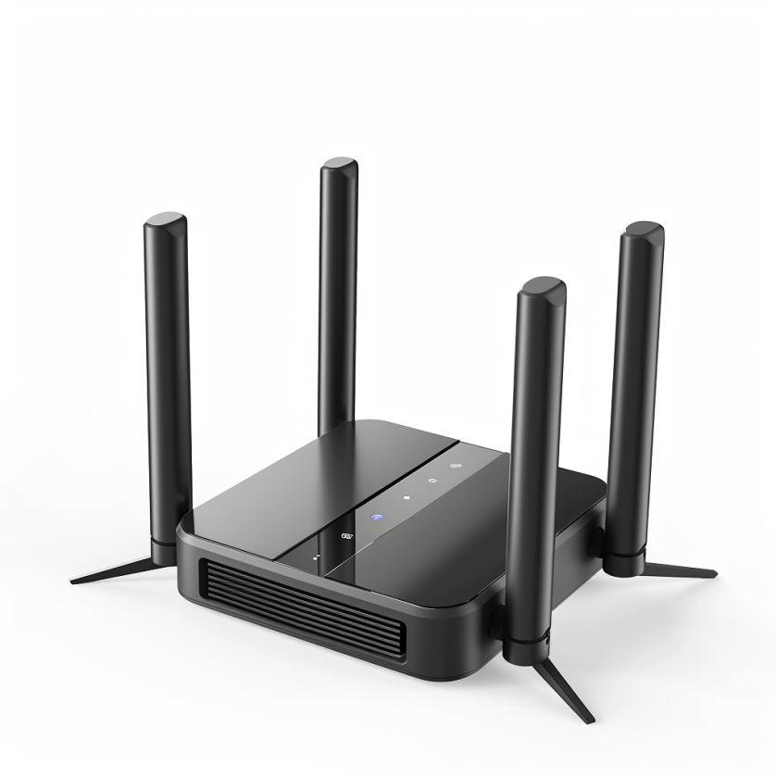

Radio transceivers in devices: WiFi
Notes:
First, we look at the computational elements, and these consist of a microcontroller or an FPGA. Today, we find that these computational elements consume at least one order of magnitude higher power consumption when compared to the commonly used sensors.
However, we also find that microcontrollers are increasingly becoming energy efficient. We investigate a typical microcontroller that has been used in sensor platforms over the past two decades. We find that energy efficiency has improved by almost two orders of magnitude. Some of the present-generation microcontrollers, such as Ambiq Apollo4 consume just 3 uA/MHz than 330 uA for MSP430 used on platforms such as TelOS B.
If the trend continues, we can expect the microcontrollers to catch up with the sensors and become energy-efficient. This significant improvement is that the digital components are increasing becoming efficient as they follow moore’s law.

Slide 57
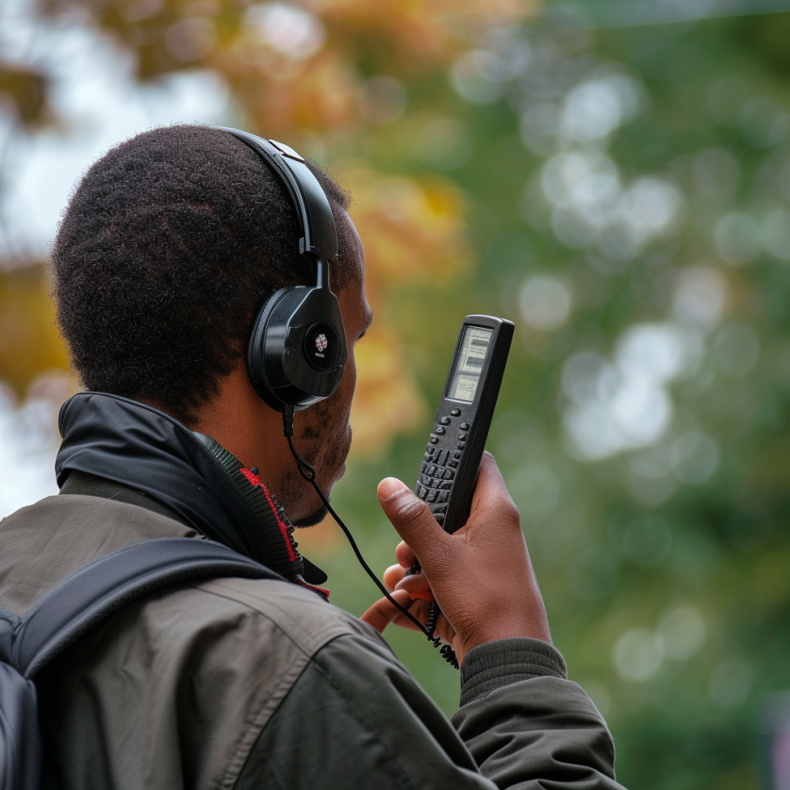
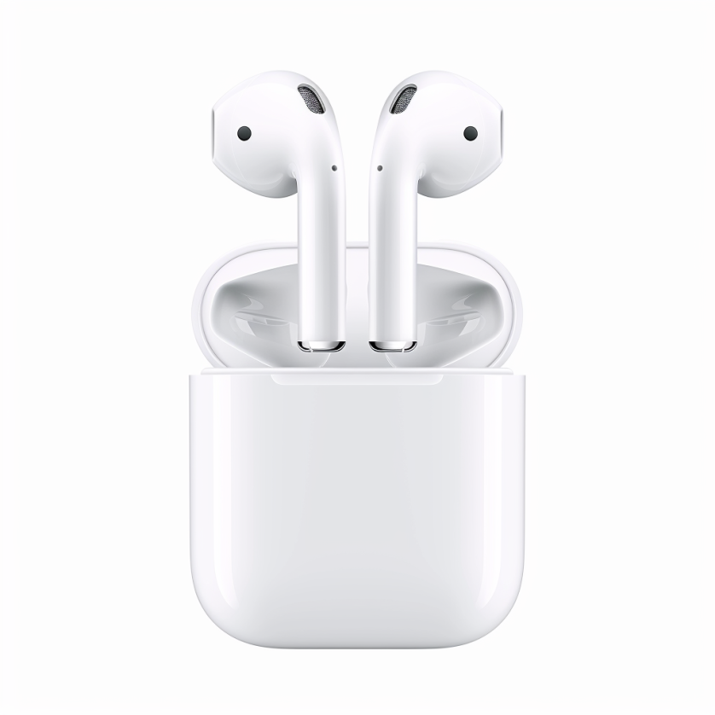
Radio transceivers in devices: Bluetooth, Walkie-Talkie
Notes:
First, we look at the computational elements, and these consist of a microcontroller or an FPGA. Today, we find that these computational elements consume at least one order of magnitude higher power consumption when compared to the commonly used sensors.
However, we also find that microcontrollers are increasingly becoming energy efficient. We investigate a typical microcontroller that has been used in sensor platforms over the past two decades. We find that energy efficiency has improved by almost two orders of magnitude. Some of the present-generation microcontrollers, such as Ambiq Apollo4 consume just 3 uA/MHz than 330 uA for MSP430 used on platforms such as TelOS B.
If the trend continues, we can expect the microcontrollers to catch up with the sensors and become energy-efficient. This significant improvement is that the digital components are increasing becoming efficient as they follow moore’s law.

Slide 58
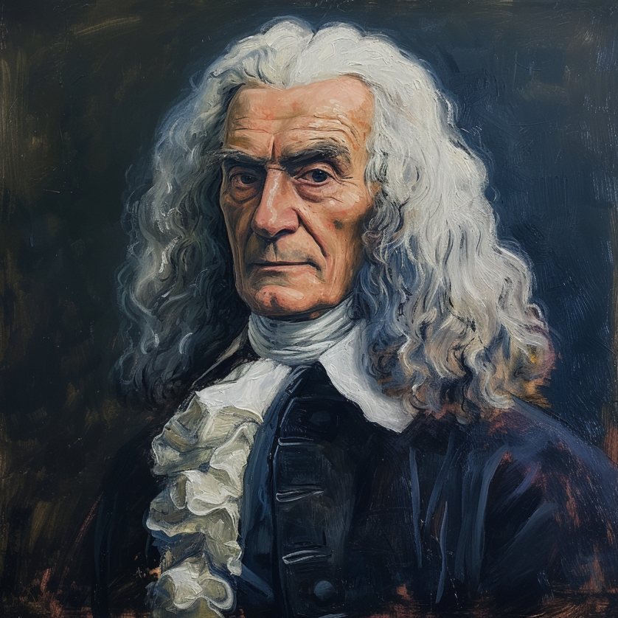
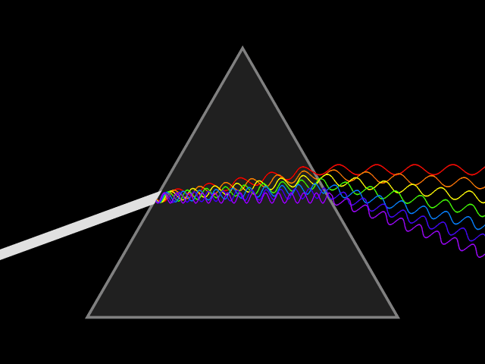
What do you mean by spectrum? Radio spectrum?
In the 17th century, Isaac Newton introduced the concept of the spectrum to the field of physical sciences, specifically in optics. He used this term to describe the array of colors visible when white light passed through a prism and was separated into its constituent hues. Later the term was expanded to include other waves, including radio waves.
Notes:
First, we look at the computational elements, and these consist of a microcontroller or an FPGA. Today, we find that these computational elements consume at least one order of magnitude higher power consumption when compared to the commonly used sensors.
However, we also find that microcontrollers are increasingly becoming energy efficient. We investigate a typical microcontroller that has been used in sensor platforms over the past two decades. We find that energy efficiency has improved by almost two orders of magnitude. Some of the present-generation microcontrollers, such as Ambiq Apollo4 consume just 3 uA/MHz than 330 uA for MSP430 used on platforms such as TelOS B.
If the trend continues, we can expect the microcontrollers to catch up with the sensors and become energy-efficient. This significant improvement is that the digital components are increasing becoming efficient as they follow moore’s law.

Slide 59
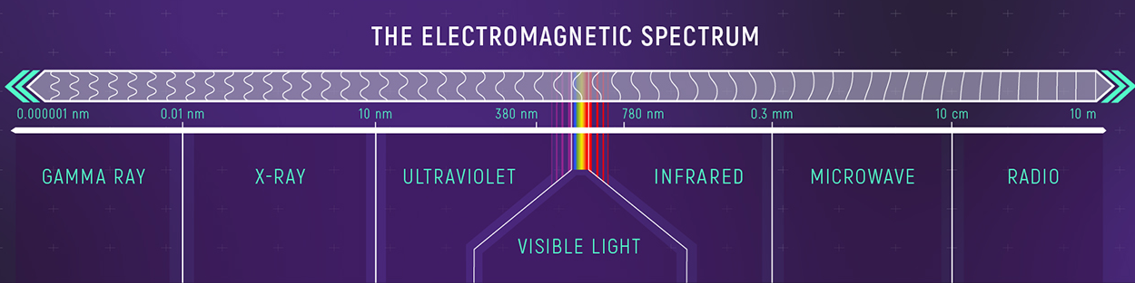
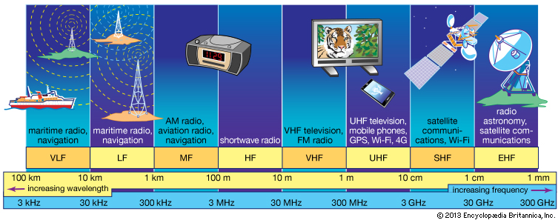
Radio waves most important part of EM spectrum
Notes:
First, we look at the computational elements, and these consist of a microcontroller or an FPGA. Today, we find that these computational elements consume at least one order of magnitude higher power consumption when compared to the commonly used sensors.
However, we also find that microcontrollers are increasingly becoming energy efficient. We investigate a typical microcontroller that has been used in sensor platforms over the past two decades. We find that energy efficiency has improved by almost two orders of magnitude. Some of the present-generation microcontrollers, such as Ambiq Apollo4 consume just 3 uA/MHz than 330 uA for MSP430 used on platforms such as TelOS B.
If the trend continues, we can expect the microcontrollers to catch up with the sensors and become energy-efficient. This significant improvement is that the digital components are increasing becoming efficient as they follow moore’s law.

Slide 60
How are radio waves characterized?
Radio waves can be characterized based on following parameters:
Strength/Power: energy contained in the radio wave
Frequency: rate of periodic variation between electric and magnetic field
Bandwidth: range of frequencies of radio waves present in the transmission
Polarization: orientation of electric field. May be circular, elliptical or linear
Modulation: variation of waves property to encode information
Notes:
First, we look at the computational elements, and these consist of a microcontroller or an FPGA. Today, we find that these computational elements consume at least one order of magnitude higher power consumption when compared to the commonly used sensors.
However, we also find that microcontrollers are increasingly becoming energy efficient. We investigate a typical microcontroller that has been used in sensor platforms over the past two decades. We find that energy efficiency has improved by almost two orders of magnitude. Some of the present-generation microcontrollers, such as Ambiq Apollo4 consume just 3 uA/MHz than 330 uA for MSP430 used on platforms such as TelOS B.
If the trend continues, we can expect the microcontrollers to catch up with the sensors and become energy-efficient. This significant improvement is that the digital components are increasing becoming efficient as they follow moore’s law.

Slide 61
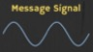
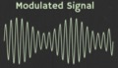
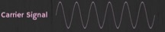
How are radio waves modified to carry information
Encoding information “baseband" in an analog “carrier” signal
Baseband signal often much lower in frequency than the carrier
Frequency of the carrier signal dictates the part of the radio spectrum
Why? baseband signals or information change is at much lower rate
Speech: upto 20 KHz, temperature changes – few Hz
Enables a better usage of the radio spectrum
Enables communication among several devices sharing the spectrum
Modulation
Notes:
First, we look at the computational elements, and these consist of a microcontroller or an FPGA. Today, we find that these computational elements consume at least one order of magnitude higher power consumption when compared to the commonly used sensors.
However, we also find that microcontrollers are increasingly becoming energy efficient. We investigate a typical microcontroller that has been used in sensor platforms over the past two decades. We find that energy efficiency has improved by almost two orders of magnitude. Some of the present-generation microcontrollers, such as Ambiq Apollo4 consume just 3 uA/MHz than 330 uA for MSP430 used on platforms such as TelOS B.
If the trend continues, we can expect the microcontrollers to catch up with the sensors and become energy-efficient. This significant improvement is that the digital components are increasing becoming efficient as they follow moore’s law.

Slide 62
What are different modulation techniques?
Vary frequency, amplitude, phase of carrier signal according message signal
We can also vary them together to support complex modulation schemes
Analog and Digital counterparts of these modulation schemes exist
Modulation
Notes:
First, we look at the computational elements, and these consist of a microcontroller or an FPGA. Today, we find that these computational elements consume at least one order of magnitude higher power consumption when compared to the commonly used sensors.
However, we also find that microcontrollers are increasingly becoming energy efficient. We investigate a typical microcontroller that has been used in sensor platforms over the past two decades. We find that energy efficiency has improved by almost two orders of magnitude. Some of the present-generation microcontrollers, such as Ambiq Apollo4 consume just 3 uA/MHz than 330 uA for MSP430 used on platforms such as TelOS B.
If the trend continues, we can expect the microcontrollers to catch up with the sensors and become energy-efficient. This significant improvement is that the digital components are increasing becoming efficient as they follow moore’s law.

Slide 63
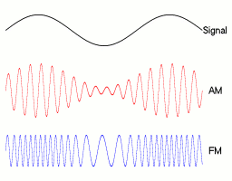
Amplitude modulation: vary amplitude of carrier signal
Change amplitude of a carrier signal according to the message signal
Simplest and the earliest introduced modulation technique
Remains widely used for radio broadcast, also computer communication
Disadvantage: signal prone to interference, less bandwidth efficient
Notes:
First, we look at the computational elements, and these consist of a microcontroller or an FPGA. Today, we find that these computational elements consume at least one order of magnitude higher power consumption when compared to the commonly used sensors.
However, we also find that microcontrollers are increasingly becoming energy efficient. We investigate a typical microcontroller that has been used in sensor platforms over the past two decades. We find that energy efficiency has improved by almost two orders of magnitude. Some of the present-generation microcontrollers, such as Ambiq Apollo4 consume just 3 uA/MHz than 330 uA for MSP430 used on platforms such as TelOS B.
If the trend continues, we can expect the microcontrollers to catch up with the sensors and become energy-efficient. This significant improvement is that the digital components are increasing becoming efficient as they follow moore’s law.

Slide 64
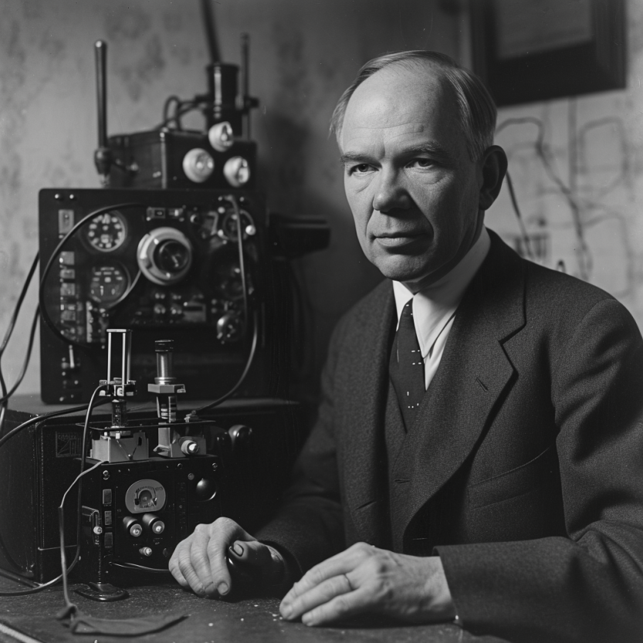
Frequency modulation: vary frequency of carrier signal
Change frequency of a carrier signal according to the message signal
Advantages (over AM): Resilient to interference, spectrum efficiency
Remains widely used for radio broadcast, also computer communication
First demonstrated by Armstrong in 1935!
Notes:
First, we look at the computational elements, and these consist of a microcontroller or an FPGA. Today, we find that these computational elements consume at least one order of magnitude higher power consumption when compared to the commonly used sensors.
However, we also find that microcontrollers are increasingly becoming energy efficient. We investigate a typical microcontroller that has been used in sensor platforms over the past two decades. We find that energy efficiency has improved by almost two orders of magnitude. Some of the present-generation microcontrollers, such as Ambiq Apollo4 consume just 3 uA/MHz than 330 uA for MSP430 used on platforms such as TelOS B.
If the trend continues, we can expect the microcontrollers to catch up with the sensors and become energy-efficient. This significant improvement is that the digital components are increasing becoming efficient as they follow moore’s law.

Slide 65
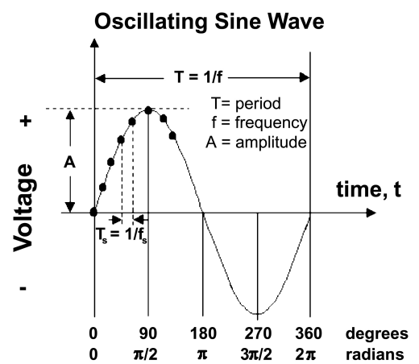
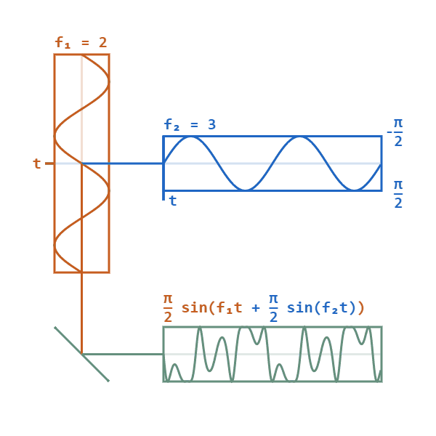
Phase modulation: vary phase of carrier signal
Change phase of a carrier signal according to the message signal
It is an integral part of modern communication standards: WiFi, Television
Advantages (over FM): Better SNR, spectral efficiency
Notes:
First, we look at the computational elements, and these consist of a microcontroller or an FPGA. Today, we find that these computational elements consume at least one order of magnitude higher power consumption when compared to the commonly used sensors.
However, we also find that microcontrollers are increasingly becoming energy efficient. We investigate a typical microcontroller that has been used in sensor platforms over the past two decades. We find that energy efficiency has improved by almost two orders of magnitude. Some of the present-generation microcontrollers, such as Ambiq Apollo4 consume just 3 uA/MHz than 330 uA for MSP430 used on platforms such as TelOS B.
If the trend continues, we can expect the microcontrollers to catch up with the sensors and become energy-efficient. This significant improvement is that the digital components are increasing becoming efficient as they follow moore’s law.

Slide 66
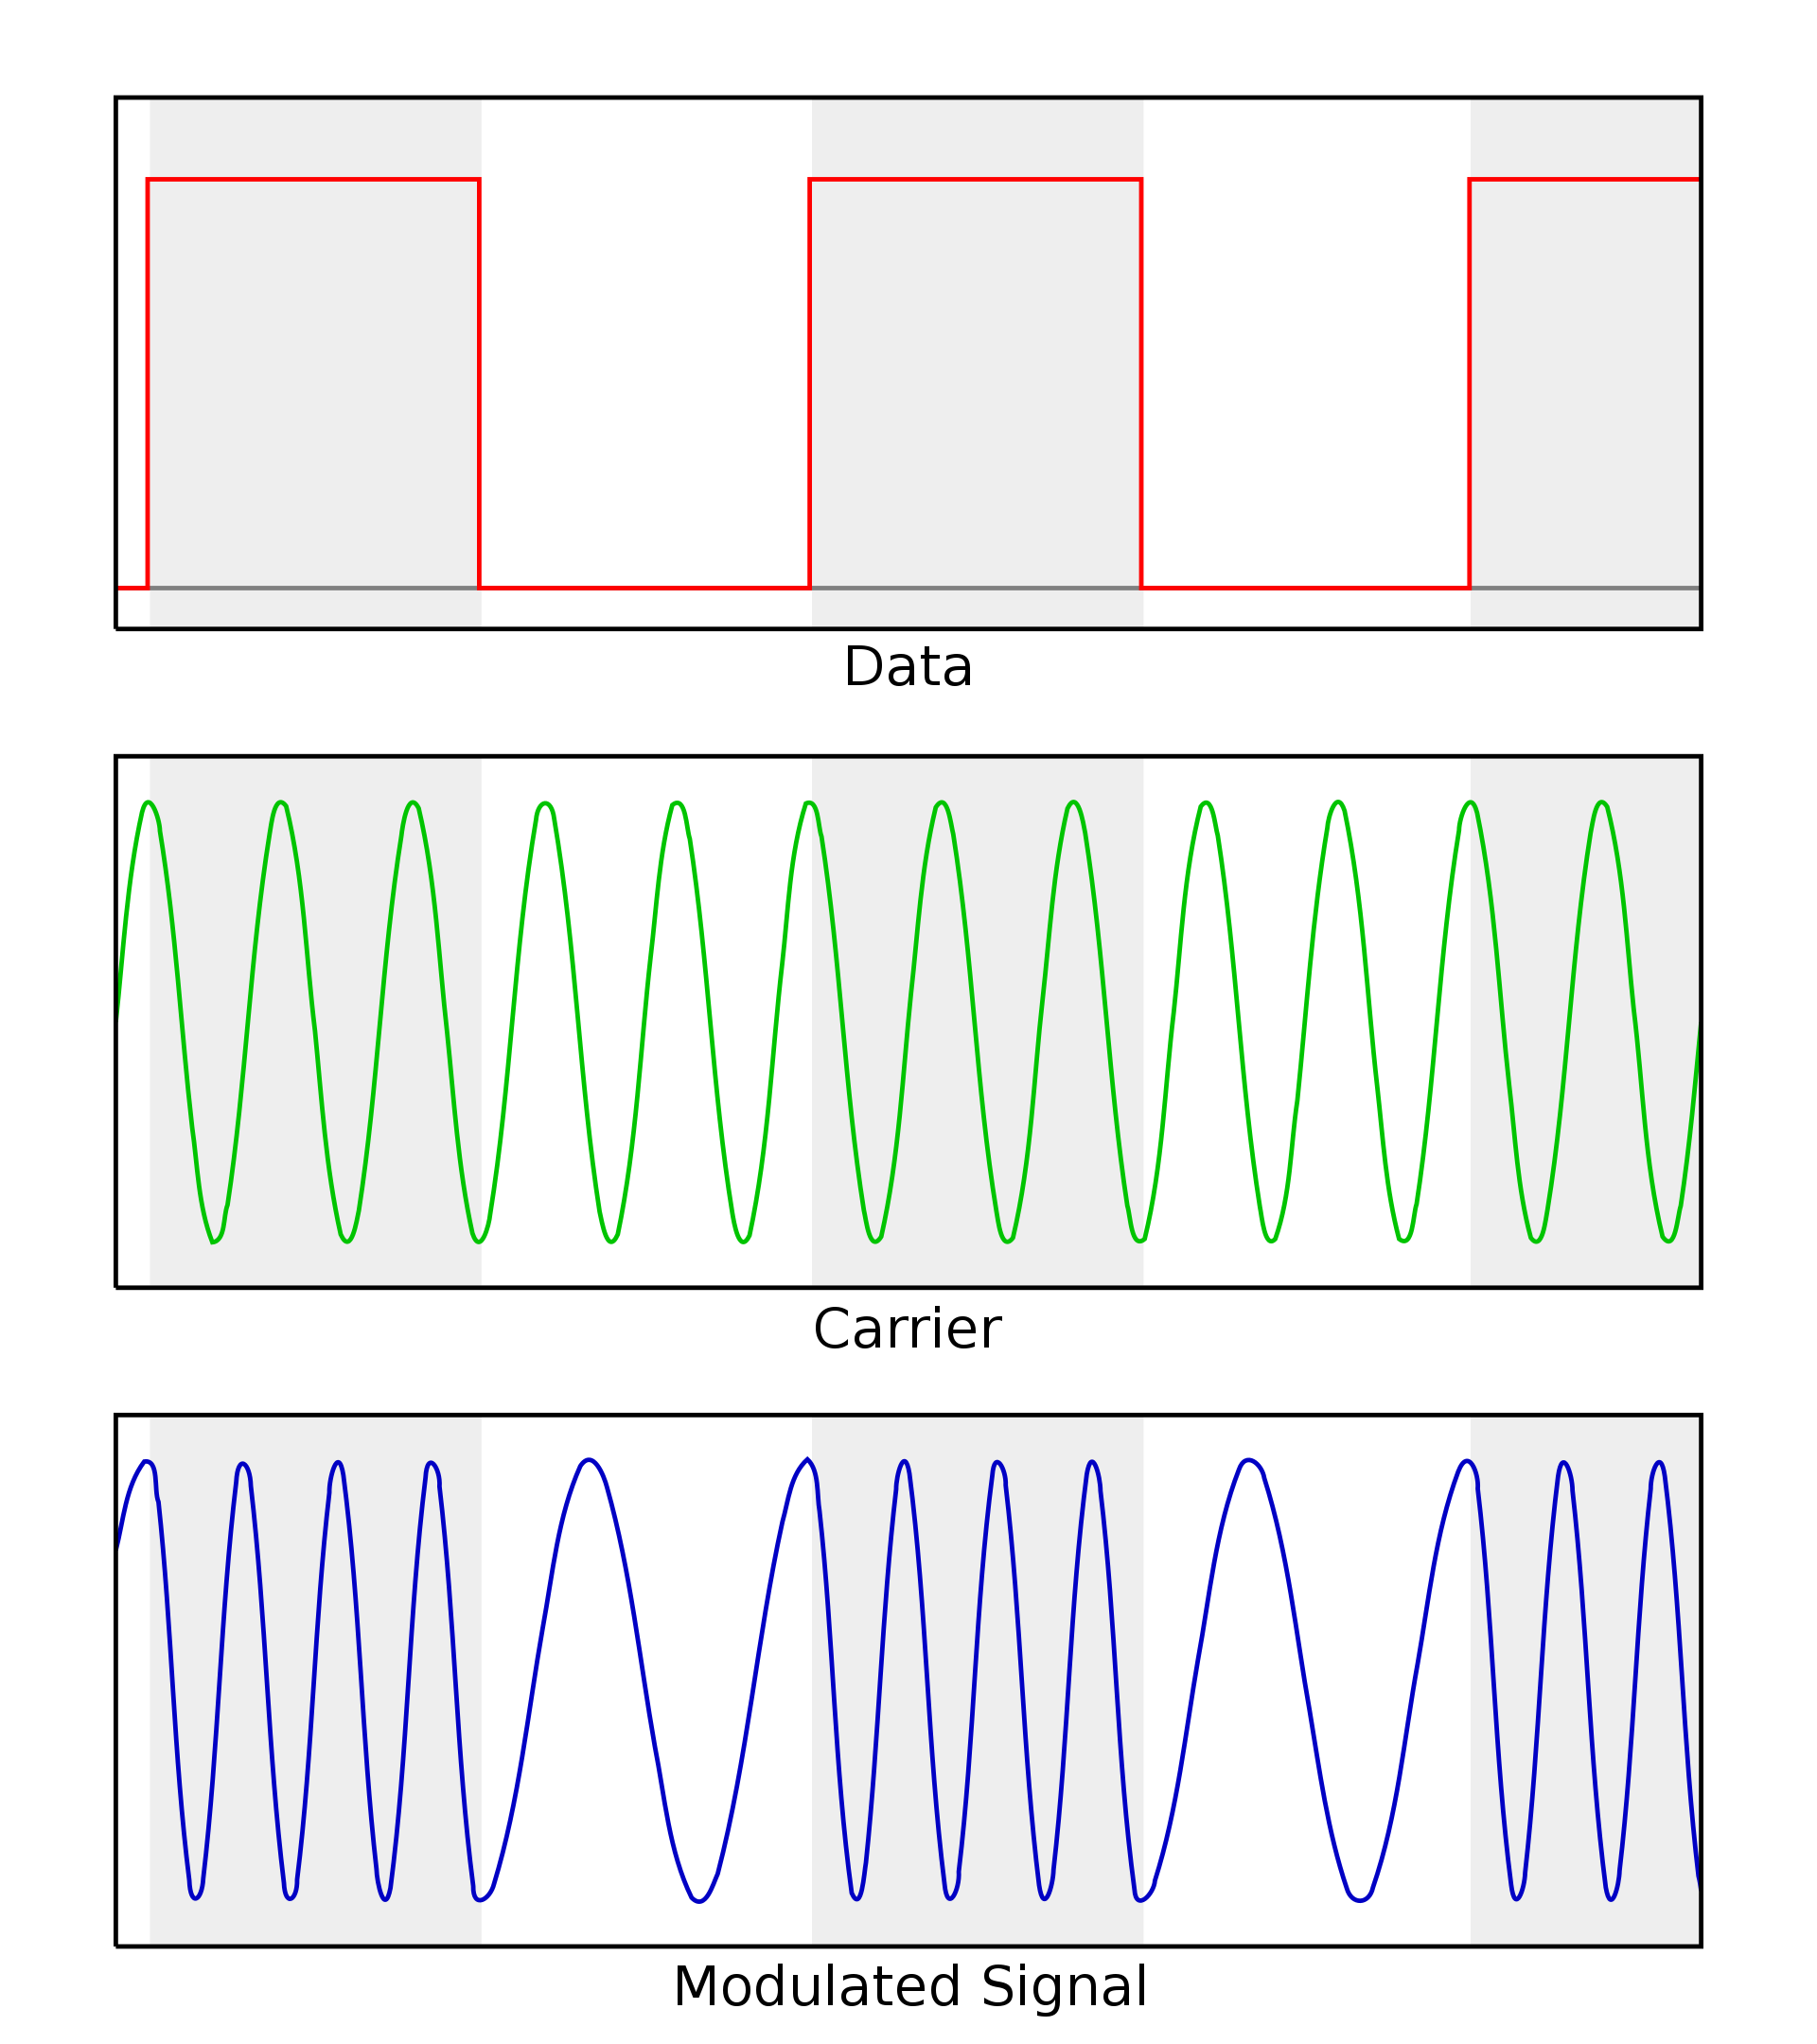
Digital equivalent of the AM, FM and PM modulation
Digital variant of these schemes vary analog signal according to digital bits
ASK: amplitude shift keying
FSK: frequency shift keying
PSK: phase shift keying
Digital variants relevant when we talk about computer communication
Notes:
First, we look at the computational elements, and these consist of a microcontroller or an FPGA. Today, we find that these computational elements consume at least one order of magnitude higher power consumption when compared to the commonly used sensors.
However, we also find that microcontrollers are increasingly becoming energy efficient. We investigate a typical microcontroller that has been used in sensor platforms over the past two decades. We find that energy efficiency has improved by almost two orders of magnitude. Some of the present-generation microcontrollers, such as Ambiq Apollo4 consume just 3 uA/MHz than 330 uA for MSP430 used on platforms such as TelOS B.
If the trend continues, we can expect the microcontrollers to catch up with the sensors and become energy-efficient. This significant improvement is that the digital components are increasing becoming efficient as they follow moore’s law.

Slide 67
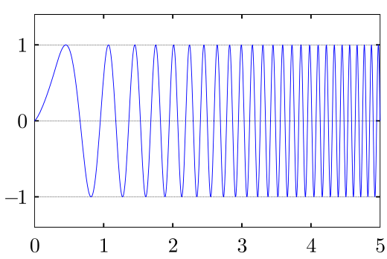
Even more complex modulation schemes exist
Builds on simple modulation schemes AM, FM, PM (or digital equivalent)
Briefly cover some during later part of the course
Complex modulation schemes ensure better performance
Spectral efficiency
Higher range
Higher throughput
……
Choice of the modulation scheme depends on the target application
Notes:
First, we look at the computational elements, and these consist of a microcontroller or an FPGA. Today, we find that these computational elements consume at least one order of magnitude higher power consumption when compared to the commonly used sensors.
However, we also find that microcontrollers are increasingly becoming energy efficient. We investigate a typical microcontroller that has been used in sensor platforms over the past two decades. We find that energy efficiency has improved by almost two orders of magnitude. Some of the present-generation microcontrollers, such as Ambiq Apollo4 consume just 3 uA/MHz than 330 uA for MSP430 used on platforms such as TelOS B.
If the trend continues, we can expect the microcontrollers to catch up with the sensors and become energy-efficient. This significant improvement is that the digital components are increasing becoming efficient as they follow moore’s law.

Slide 68
How radio waves propagate to the receiver
Antenna
Radio frequency signal
Transmitting
Device
Receiving Device

Slide 69
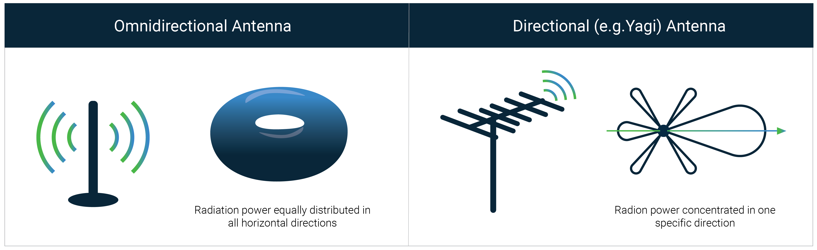
How radio waves radiate out from transceiver
Antenna: An electrical conductor or system of conductors
Transmission: radio frequency electrical energy converted into electromagnetic energy
Reception: the reverse occurs, electromagnetic energy converted into electrical energy
Antennas can be categorized intro directional or omnidirectional
Based on the radiation pattern of the antenna

Slide 70
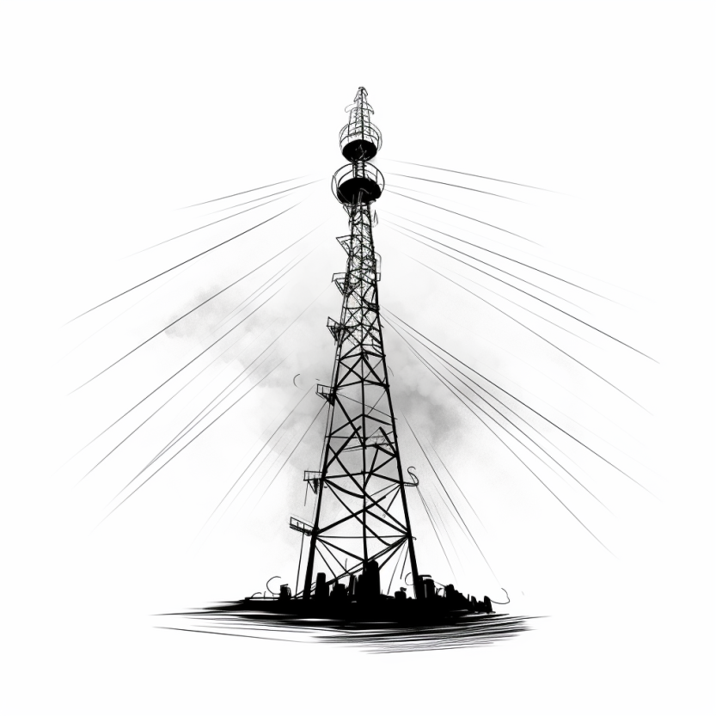
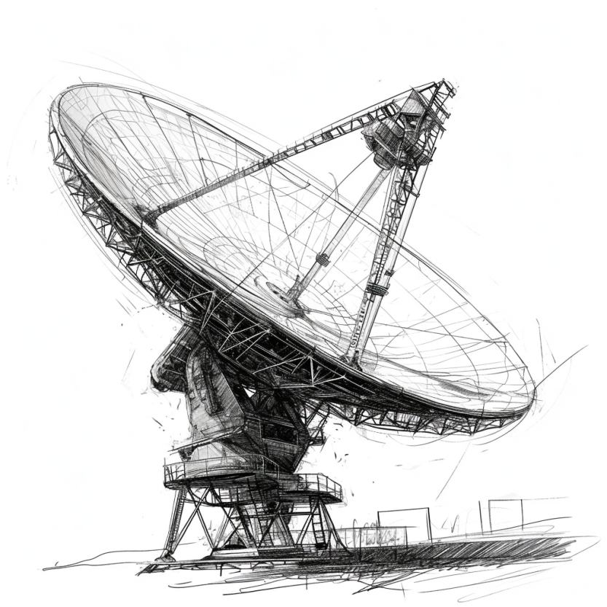


Common antenna types used for communication
Monopole: A straight wire mounted on conductive surface (ground plane)
Array: A set of connected antenna elements working together
Loop: A loop or wire or a conductor that acts like an antenna
Aperture: Transmits/receives electromagnetic wave through a hole
….. (and even more exists) …..

Slide 71


Dipole antenna types used for communication
Dipole antenna: A simple antenna consisting of wires pointed in opposite directions arranged either horizontally or vertically, with end of each wire connected to the radio and the other end is hanging in the free space
Half-wave dipole: A more efficient variation of dipole antenna is the half-wave dipole antenna, which radiates energy efficiently when the wavelength of radio signal is twice the electrical length of the antenna

Slide 72

Relationship between antenna size and frequency
Antenna size is inversely proportional to the frequency of radio wave
Higher the frequency, smaller the antenna size
Lower frequency, larger is the antenna size
For example:
Dipole: Length of the conductor is half of the wave length of radio wave
Half-wave dipole: Length of conductor is quarter wavelength of radio wave

Slide 73
Understanding the performance of an antenna
Gain of antenna: It is a dimensionless quantity that measures the ability of an antenna to direct or receive radio waves in a particular direction compared to a reference. It is usually measured in the unit of decibel (dB)
Often measured in reference to hypothetical isotropic antenna (dBi)
Can be measured in reference to a halfwave dipole antenna (dBd)
Antennas are reciprocal in nature. Transmit and receive equally well
Tradeoffs: Higher the gain, more directional is the transmission and reception, and the narrower would be the beam

Slide 74
Understanding the performance of an antenna
Power output, in a particular direction, compared to that produced in any direction by a perfect omni-directional antenna (isotropic antenna)‏
Effective area: related to physical size and shape of antenna
Relationship between antenna gain and effective area
G = antenna gain
A_{e} = effective area
f = carrier frequency
c = speed of light 3 X 10⁸ m/s
Lambda = carrier wavelength

Slide 75


Revisiting antennas and their gain
Yagi-uda antenna. It has a very high gain. The gain and directionality increases with the number of antenna elements.
Antenna Gain: 23 dBi
Antenna Gain: 8 dBi

Slide 76


Revisiting antennas and their gain
Chip antenna makes sacrifice due to smaller form factor and hence the least gain. Whip antenna has less directionality than Yagi-uda antenna.
Antenna Gain: -1 dBi
Antenna Gain: 3.8 dBi

Slide 77


How do radio waves propagate from TX to RX?
Medium and environment has an important role to play in propagation
Radio waves do not propagate well underwater. Submarines uses sound
Environment impacts the radio wave propagation significantly
Reduced communication range
Interference from other devices
Issues with reliability
…… and many more

Slide 78
Radio propagation is complex in real-world, especially when obstacles are present

Slide 79

Radio propagation is complex in real-world, especially when obstacles are present
Reflection
e.g. earth surface, buildings
Diffraction
Radio wave bends around the obstacle
Scattering
Obstacles smaller than wavelength of wave (e.g. foliage)
Signal is scattered into several weaker signals

Slide 80

Radio waves propagation in line-of-sight
Transmitting and receiving antennas must be within line of sight
Satellite communication – signal above 30 MHz not reflected by ionosphere
Ground communication – antennas in effective line of site due to refraction

Slide 81

Long range wireless transmissions using IoT devices

Slide 82


Non-line of sight propagation of radio waves
Transmitter and receiver are not kept in line of sight
Radio waves encounter obstacles, may go through walls, buildings
Much more applicable to read world environment and deployments
Significantly impacts the communication range and reliability

Slide 83
Estimating received signal strength and range: Friis propagation model
f_{c} is the center frequency in Hz
c is speed of light
d is the distance between transmitter and receiver
Alpha is the path loss component
G is antenna gain

Slide 84
Path Loss Exponent
Environment
Path Loss Exponential (α)
Free Space
2
Urban area cellualr radio
2.7 to 3.5
Shadowed urban cellular radio
3 to 5
In building LOS
1.6 to 1.8
Obstructed in building
4 to 6
Obstructed in factory
2 to 3
Rapport, Table 4.2, pp139

Slide 85

Attenuation and Gain: Decibel (dB) unit
Attenuation: Means loss of energy
When signal traverses through a medium, it loses energy.
Gain: Means increase in energy
Often devices such as amplifiers are employed to improve the signal strength
Commonly, we use decibel to calculate gain or loss/attenuation of signal
dB = 10log₁₀P₂/P₁
P₁ - input signal, P₂ - output signal

Slide 86

Operations in decibel (dB) examples
Suppose a signal travels through a transmission medium and its power decreases to one-half of its original value, meaning that P2 is equal to (1/2)P1. In this scenario, the attenuation, or loss of power, can be determined using the following formula:
Thus, loss of 3 dB, is equivalent to losing half of the signal power

Slide 87


Operations in decibel (dB) examples
A signal passes through an amplifier, resulting in a tenfold increase in power, expressed as P2 = 10P1. The amplification, also known as the power gain, can be calculated as:
One reason engineers use decibels to measure changes in signal strength is that decibel values can be easily added or subtracted
L1 = 3b, L2 = 7 db, Combined loss: 10 dB

Slide 88

Unit of power of a signal: dBm (decibel milliwatt)
Decibel (dBm) is a measure of signal power, calculated as 10 log10 (Pm) where Pm is power in milliwatts
Example: Calculate the power of a signal with dB_{m} = −30
Caution: We can add/subtract dB and dB term together, but we cannot perform these operations on dB and dBm term and vice versa

Slide 89
Basics of wireless communication and networking
Link Budget: One of the metrics that help you understand the gains and losses in a communication system. Applicable to radio waves, communication happening through cables, and other systems
High link budget ensures that the wireless signal is received with a sufficient signal to noise (SNR) ratio for recovering of the sent information
Receiver Power (dBm) = Transmitted Power (dBm) + Gains (dB) – Losses (dB)

Slide 90

Basics of wireless communication and networking
Free space path loss (FSPL or FSL): The loss of power encountered by signal as it transmits from the transmitter to the receiver
d is the distance between the transmitter and receiver antennas (in meters),
f is the frequency of the signal (in Hertz),
c is the speed of light in a vacuum

Slide 91
Basics of wireless communication and networking
Signal to Noise (SNR) ratio: It is defined as the ratio of the desired or target signal when compared to the background noise
SNR = P(signal) / P(noise)
Often, SNR as a ratio is expressed in the units of decibel (dB)
SNR = 1, what would be the value in decibel?
We would like to have the SNR to be as high as possible. For communication systems, it means stronger desired signal, resulting in better link quality and reliability

Slide 92
Basics of wireless communication and networking
How do you estimate the capacity of the channel?
And what do you mean by the capacity of the channel?
Shannon capacity of the channel: The bandwidth available (B) , The quality of the channel (the level of noise, SNR)
C = B * log₂(1+SNR)
Intuitively, capacity increases with available bandwidth (linear) and increases with SNR (log)

Slide 93
Various tradeoffs in range, frequency, datarate, power
Power is (usually) a constraint
Increase in power can result in higher range/data rate
Lower lifespan of the device
Increase data rate (C)
Increase throughput by using a larger bandwidth (B)
Transmits at higher frequencies (f)
Range decreases and vice versa
Improve design to increase gain (G)
e.g. OFDM, MIMO etc.
C = B * log₂(1+SNR)
SNR – signal-to-noise ratio

Slide 94
Embedded Software Design
Ambuj Varshney
ambujv@nus.edu.sg
Notes:
++ Thank you for inviting me to give this talk
++ In this talk, I will present a pathway that can enable us to make wireless embedded systems ubiquitous. I will describe my previous research efforts that tackle the critical challenges that limit the growth of wireless embedded systems. These are related to the growing energy asymmetry that exists between sensing, computation and communication blocks on these platforms.
++ Finally, I will conclude my talk by covering the research agenda that I would like to work on as a faculty member.

